Slide 1

introduceꢀmyself
Speaker:
ZhangꢀJin-Gong
1

Slide 2

National Chung Hsing University (NCHU)
•M.S.ꢀinꢀLifeꢀSciences
•Sep.ꢀ2024ꢀ–ꢀAug.ꢀ2026
RNA / DNA
modelingꢀ
National Chung Hsing University (NCHU)
•B.S.ꢀinꢀPlantꢀPathology
•Jun.ꢀ2019ꢀ–ꢀJun.ꢀ2023
Professional Experience
NanhuaꢀUniversity
•ProjectꢀManagerꢀ(WebsiteꢀManagement)
•Jun.ꢀ2024ꢀ–ꢀDec.ꢀ2024
Songshan High School of Agriculture and Industry
ElectricalꢀEngineeringꢀꢀ&ꢀHorticulture
2

Slide 3

National Chung Hsing University (NCHU)
•M.S.ꢀinꢀLifeꢀSciences
•Sep.ꢀ2024ꢀ–ꢀAug.ꢀ2026
RNA / DNA
modelingꢀ
National Chung Hsing University (NCHU)
•B.S.ꢀinꢀPlantꢀPathology
•Jun.ꢀ2019ꢀ–ꢀJun.ꢀ2023
Professional Experience
NanhuaꢀUniversity
•ProjectꢀManagerꢀ(WebsiteꢀManagement)
•Jun.ꢀ2024ꢀ–ꢀDec.ꢀ2024
Songshan High School of Agriculture and Industry
ElectricalꢀEngineeringꢀꢀ&ꢀHorticulture
3

Slide 4
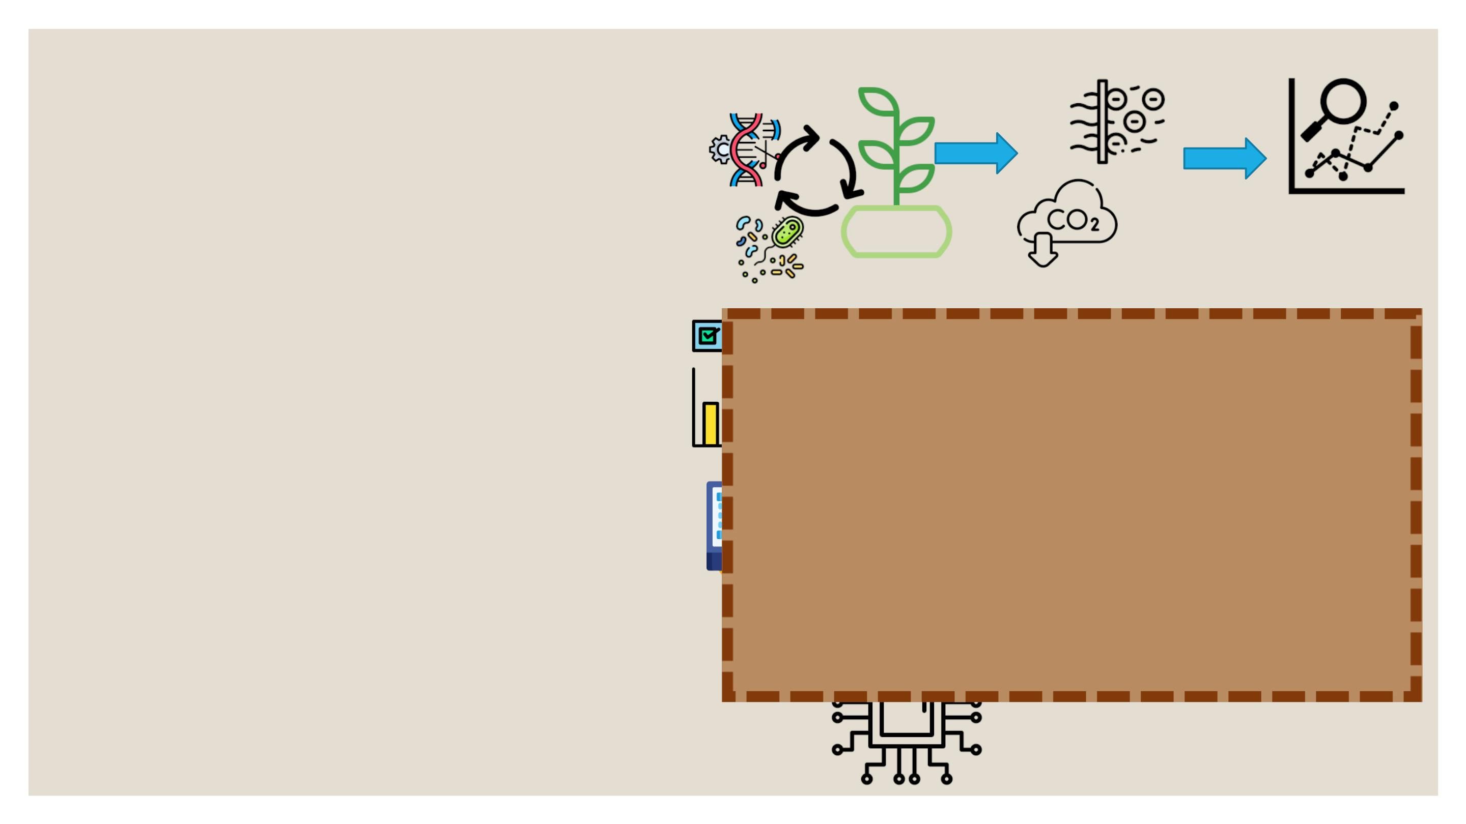
National Chung Hsing University (NCHU)
•M.S.ꢀinꢀLifeꢀSciences
•Sep.ꢀ2024ꢀ–ꢀAug.ꢀ2026
RNA / DNA
modelingꢀ
National Chung Hsing University (NCHU)
•B.S.ꢀinꢀPlantꢀPathology
•Jun.ꢀ2019ꢀ–ꢀJun.ꢀ2023
Professional Experience
NanhuaꢀUniversity
•ProjectꢀManagerꢀ(WebsiteꢀManagement)
•Jun.ꢀ2024ꢀ–ꢀDec.ꢀ2024
Songshan High School of Agriculture and Ind
ElectricalꢀEngineeringꢀꢀ&ꢀHorticulture
4

Slide 5
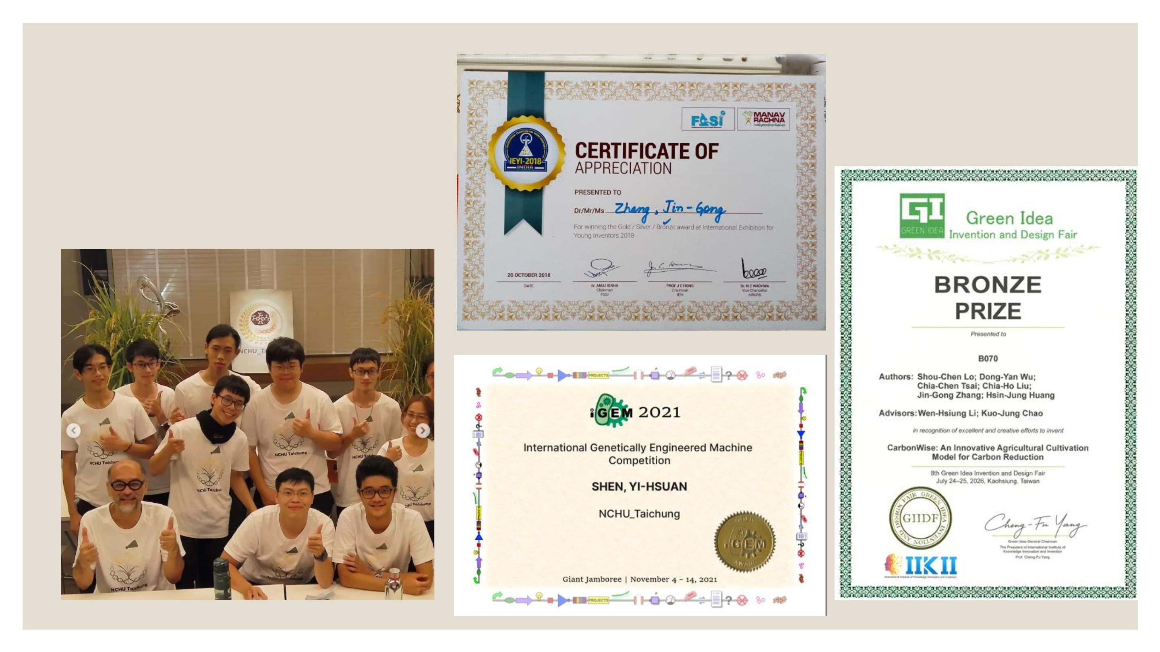
Introduction
Awardsꢀ&ꢀCertifications
2018
5
2021
2026

Slide 6
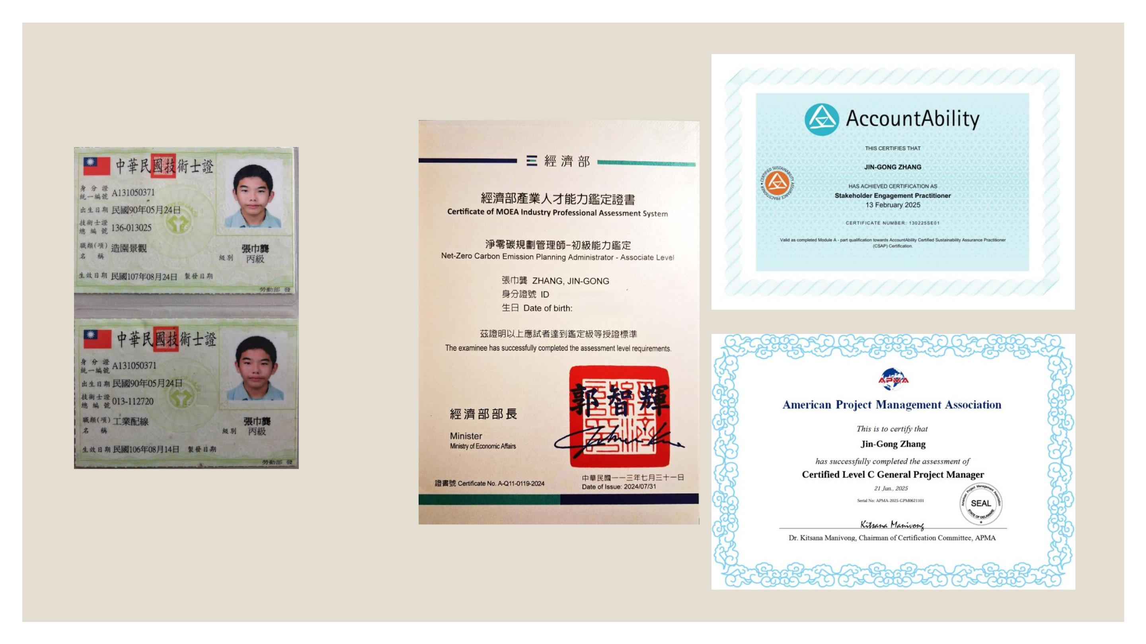
Introduction
Awardsꢀ&ꢀCertifications
2025
AA1000 SEP
2018
Industrial Wiring – Level C Certification
2024 IPAS
◦ Low-VoltageꢀWiringꢀ&ꢀPanelꢀAssembly
◦ ElectricalꢀTroubleshooting
2025
APMA
6
◦ WiringꢀDiagramsꢀ&ꢀSafety

Slide 7
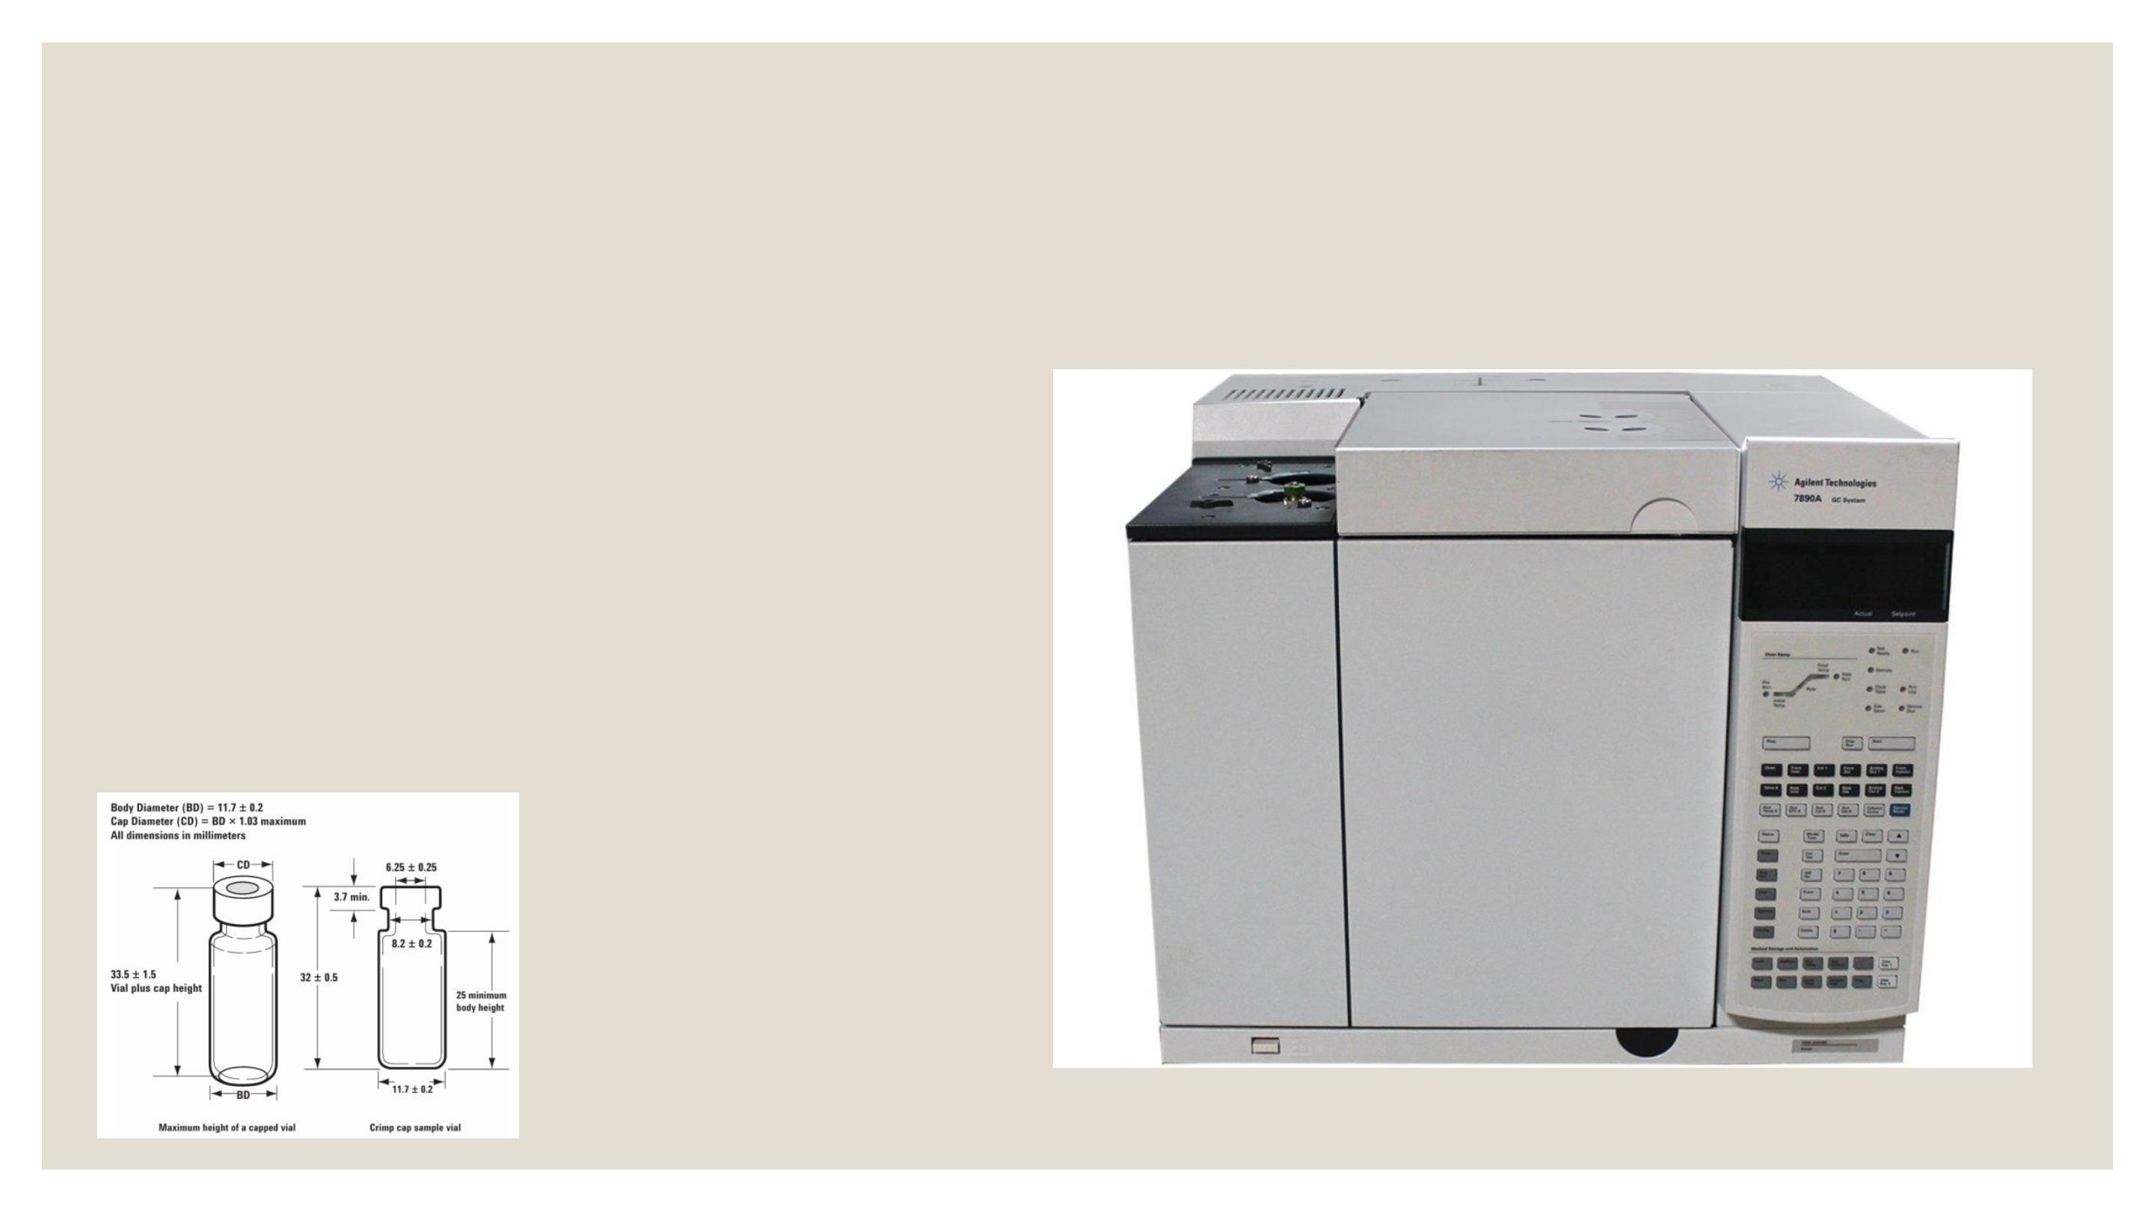
UndergraduateꢀStudies
Technicalꢀtroubleshooting
1. Label & Robotic Arm
•Verifyꢀlabelꢀdimensions.
•Ensureꢀlabelsꢀdoꢀnotꢀinterfereꢀwithꢀtheꢀroboticꢀarm.
2. FID Ignition Failure
•Checkꢀairꢀandꢀhydrogenꢀpressure.
•H₂:ꢀ>ꢀ35ꢀpsiꢀ|ꢀAir:ꢀ>ꢀ55ꢀpsi
3. Unstable Peak Area
•Checkꢀforꢀleaksꢀatꢀcolumnꢀconnections.
•EnsureꢀGCꢀisꢀfullyꢀstabilized.
•VerifyꢀMultimodeꢀandꢀSplit/Splitlessꢀinletꢀsettings.
7

Slide 8
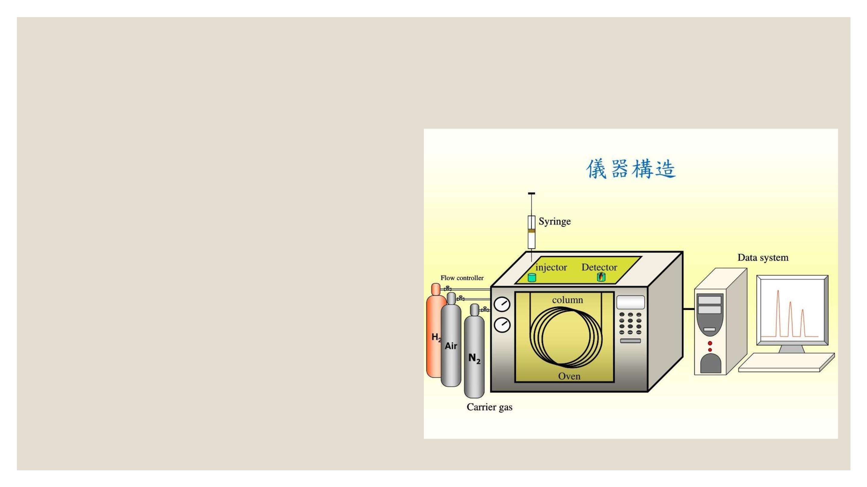
Introduction
UndergraduateꢀStudies
Root Cause Analysis – GC Contamination
1. Sample & Solvent
Runꢀblankꢀinjection.
Checkꢀsampleꢀcontaminationꢀandꢀcarryover.
2. Inlet & Gas Supply
Checkꢀseptumꢀpurgeꢀflowꢀandꢀ
contamination.
Verifyꢀgasꢀpurityꢀandꢀsupplyꢀlines.
Cleanꢀandꢀbakeꢀoutꢀtheꢀinlet.
3. Column
Bakeꢀoutꢀorꢀtrimꢀcontaminatedꢀcolumn.
Reverseꢀcolumnꢀifꢀnecessary.
4. Method & Peak
Verifyꢀovenꢀtemperatureꢀandꢀrunꢀtime.
Checkꢀforꢀunexpectedꢀpeaksꢀandꢀcarryover.
8

Slide 9
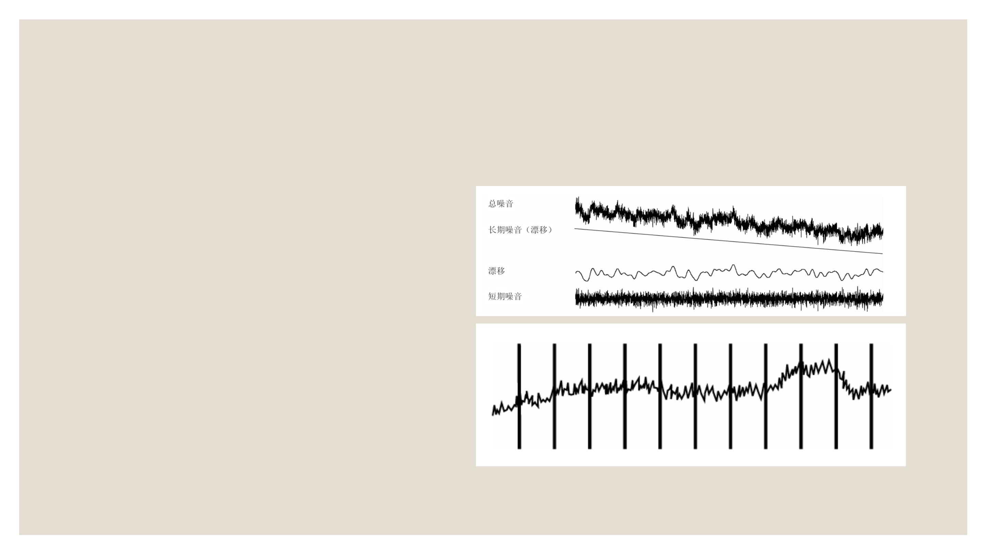
UndergraduateꢀStudies
Technicalꢀtroubleshooting
Baseline Drift
ColumnꢀConditioning
ColumnꢀLeak
ColumnꢀCompensationꢀProfileꢀ
(RisingꢀBaselineꢀDrift/FallingꢀBaselineꢀDrift)
Baseline Spikes
ElectricꢀMotors
BuildingꢀHVACꢀSystems
9

Slide 10

UndergraduateꢀStudies
Technicalꢀtroubleshooting
TCD Negative Peak Tailing
Checkꢀforꢀleaksꢀatꢀtheꢀdetectorꢀcolumnꢀadapterꢀconnection.
Upgradeꢀtheꢀdetectorꢀtoꢀaꢀmoreꢀdurableꢀfilament.
GC Not Ready
Checkꢀsystemꢀstatusꢀandꢀcomponentꢀsettings.
Inspectꢀtheꢀinjectorꢀandꢀdataꢀsystem.
Pressꢀ[PrepꢀRun]ꢀbeforeꢀmanualꢀinjectionꢀwhenꢀrequired.
VerifyꢀSplitless,ꢀPulsedꢀInjection,ꢀandꢀGasꢀSaverꢀsettings.
PC–GC Communication Failure
Checkꢀcommunicationꢀcablesꢀandꢀconnections.
Verifyꢀinterfaceꢀandꢀcommunicationꢀsettings.
Check for contamination at the split vent.
Useꢀaꢀhexꢀwrenchꢀtoꢀreplaceꢀtheꢀseptum.
10

Slide 11
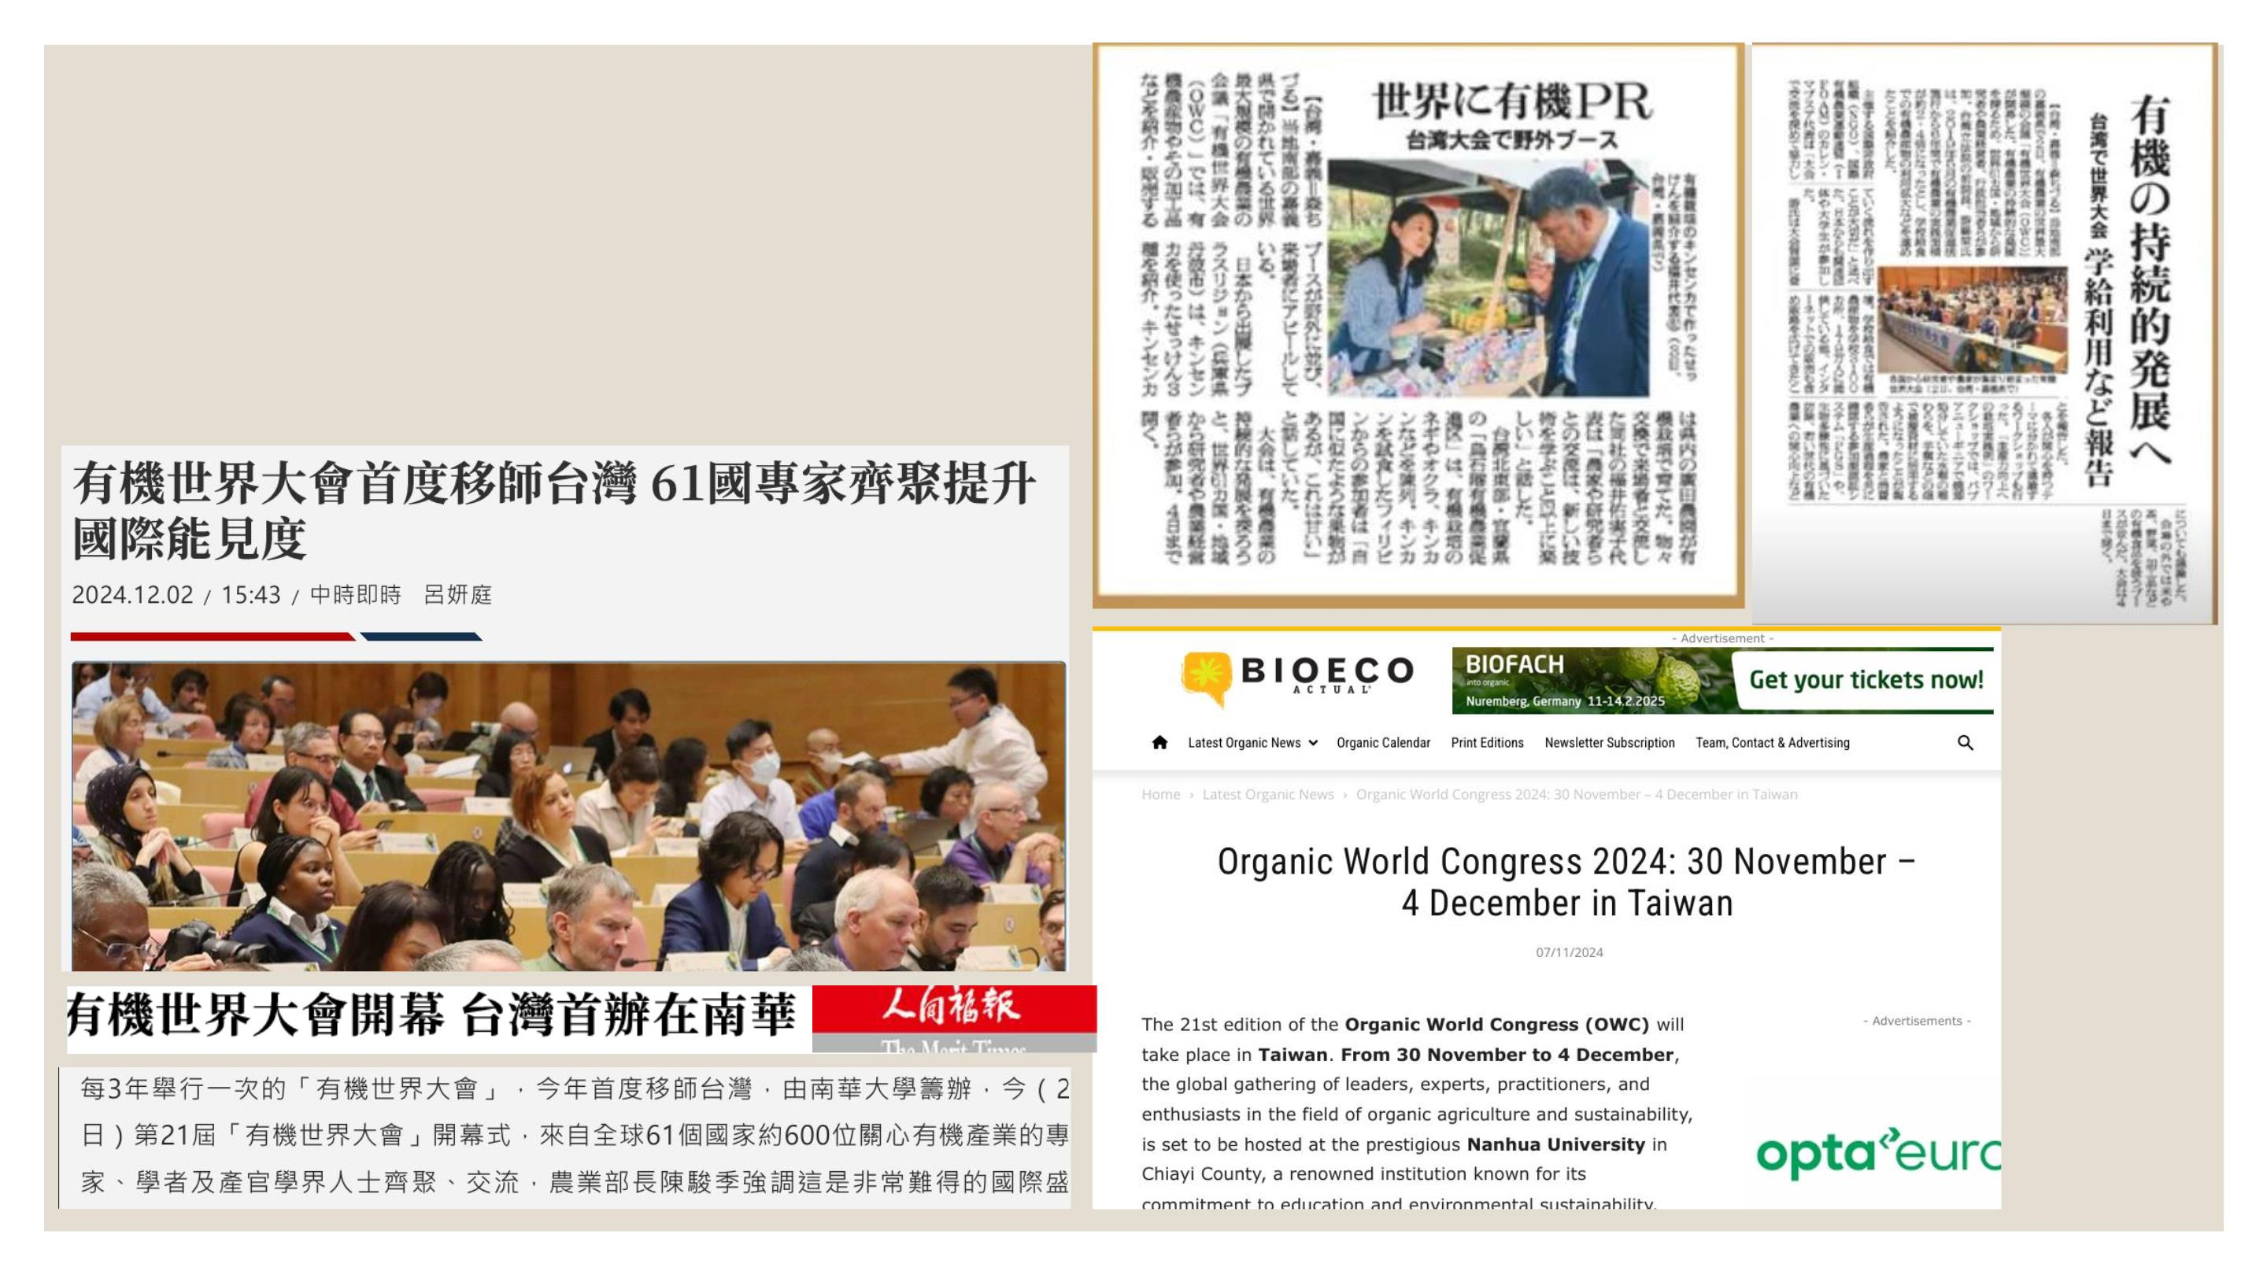
ProfessionalꢀExperience
• InternationalꢀEventꢀOrganization
• ProjectꢀOffice
• AdaptabilityꢀUnderꢀPressure
11

Slide 12
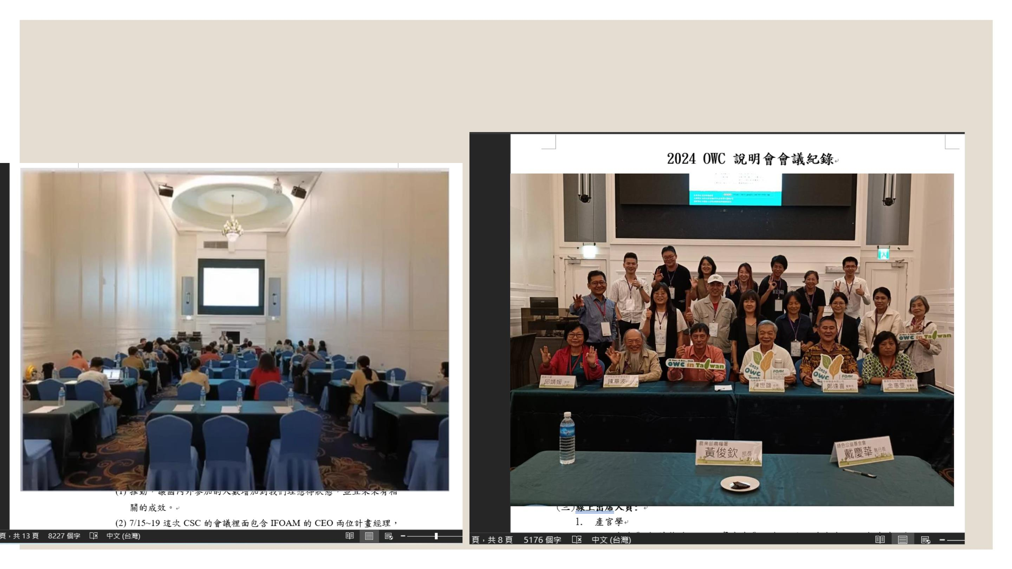
Responsibilitiesꢀ&ꢀDevelopment
1ꢀMeetingꢀMinutesꢀ(2ꢀhrꢀandꢀ6hr)
2ꢀWorkꢀScopeꢀClarification
12

Slide 13
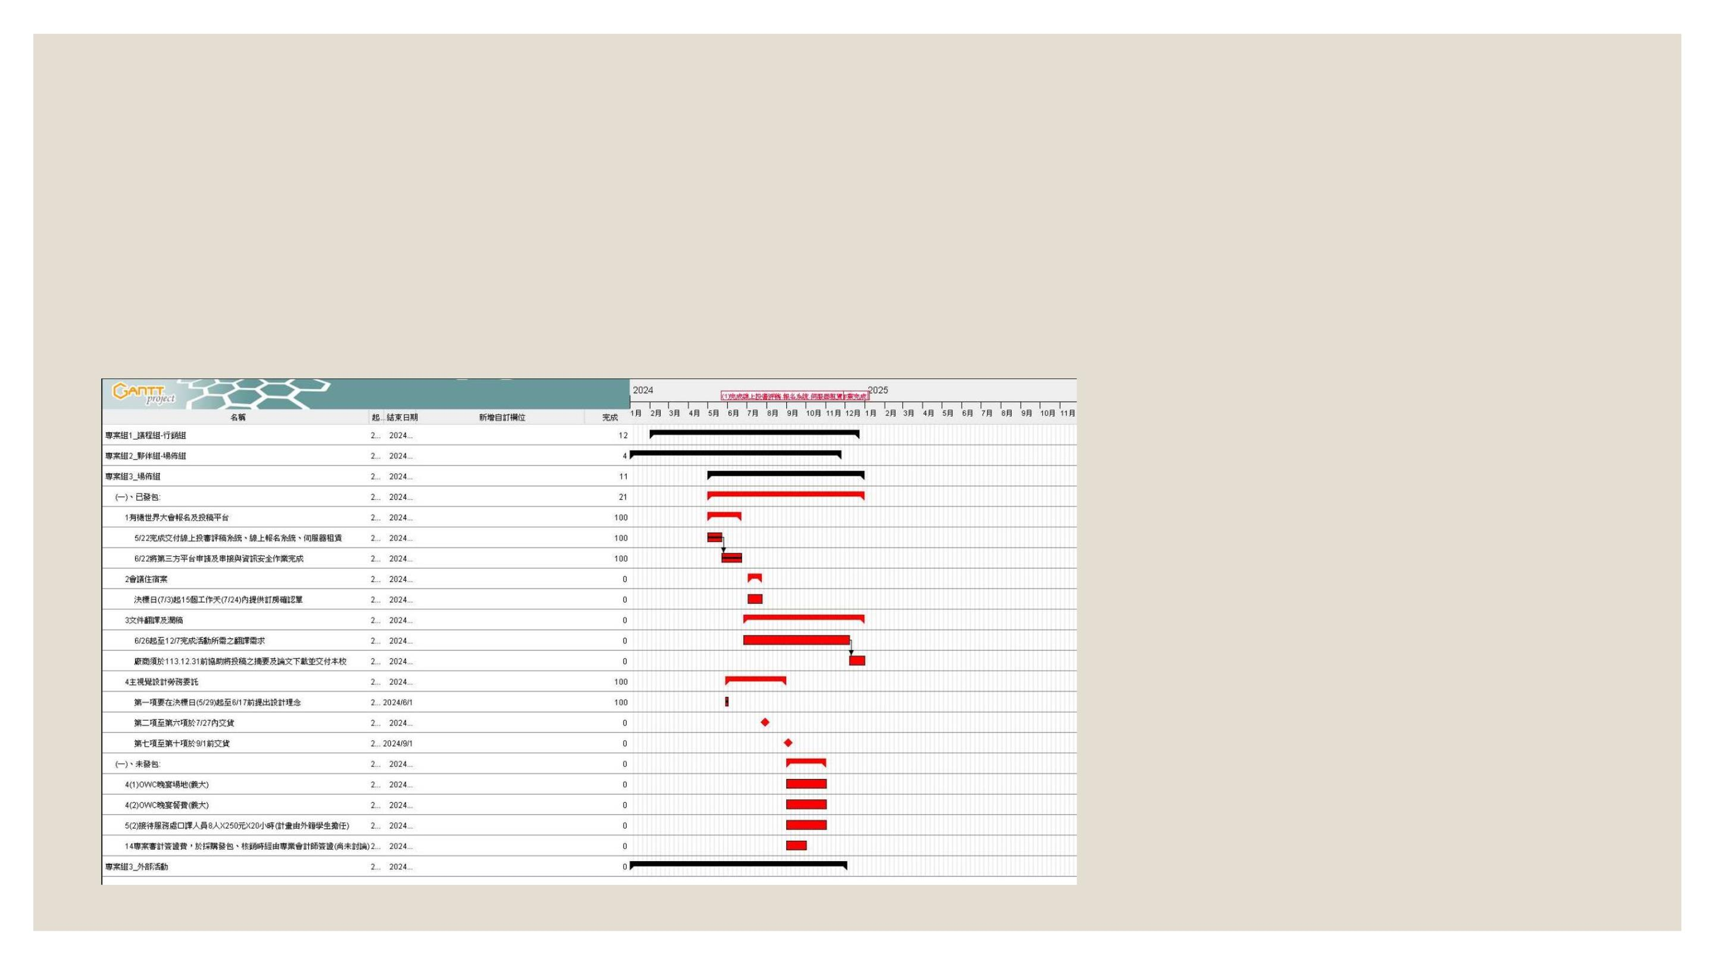
Responsibilitiesꢀ&ꢀDevelopment
3.ꢀProjectꢀProgressꢀTracking
4.ꢀProjectꢀManagementꢀTrainingꢀ&ꢀCertification
13

Slide 14
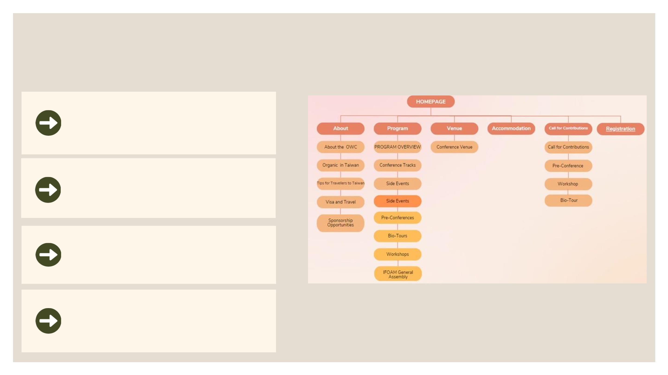
Strongꢀattentionꢀtoꢀdetailꢀandꢀanalyticalꢀthinkingꢀskills
WebsiteꢀManagement
WebsiteꢀDevelopment
WebsiteꢀPlanningꢀ&ꢀ
Maintenance
WebsiteꢀAdministration
Fig. 10 Buildꢀandꢀoptimizeꢀwebsiteꢀstructure
14

Slide 15
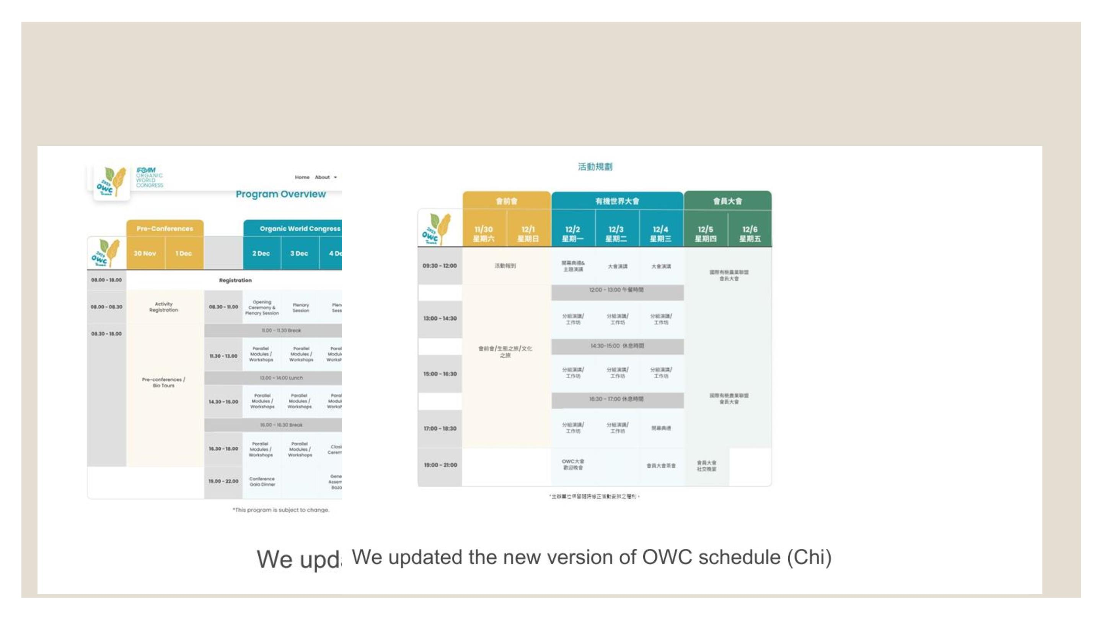
Effectiveꢀcustomer-ꢀandꢀstakeholder-focusedꢀ
communicationꢀskills.ꢀ
15

Slide 16

16

Slide 17
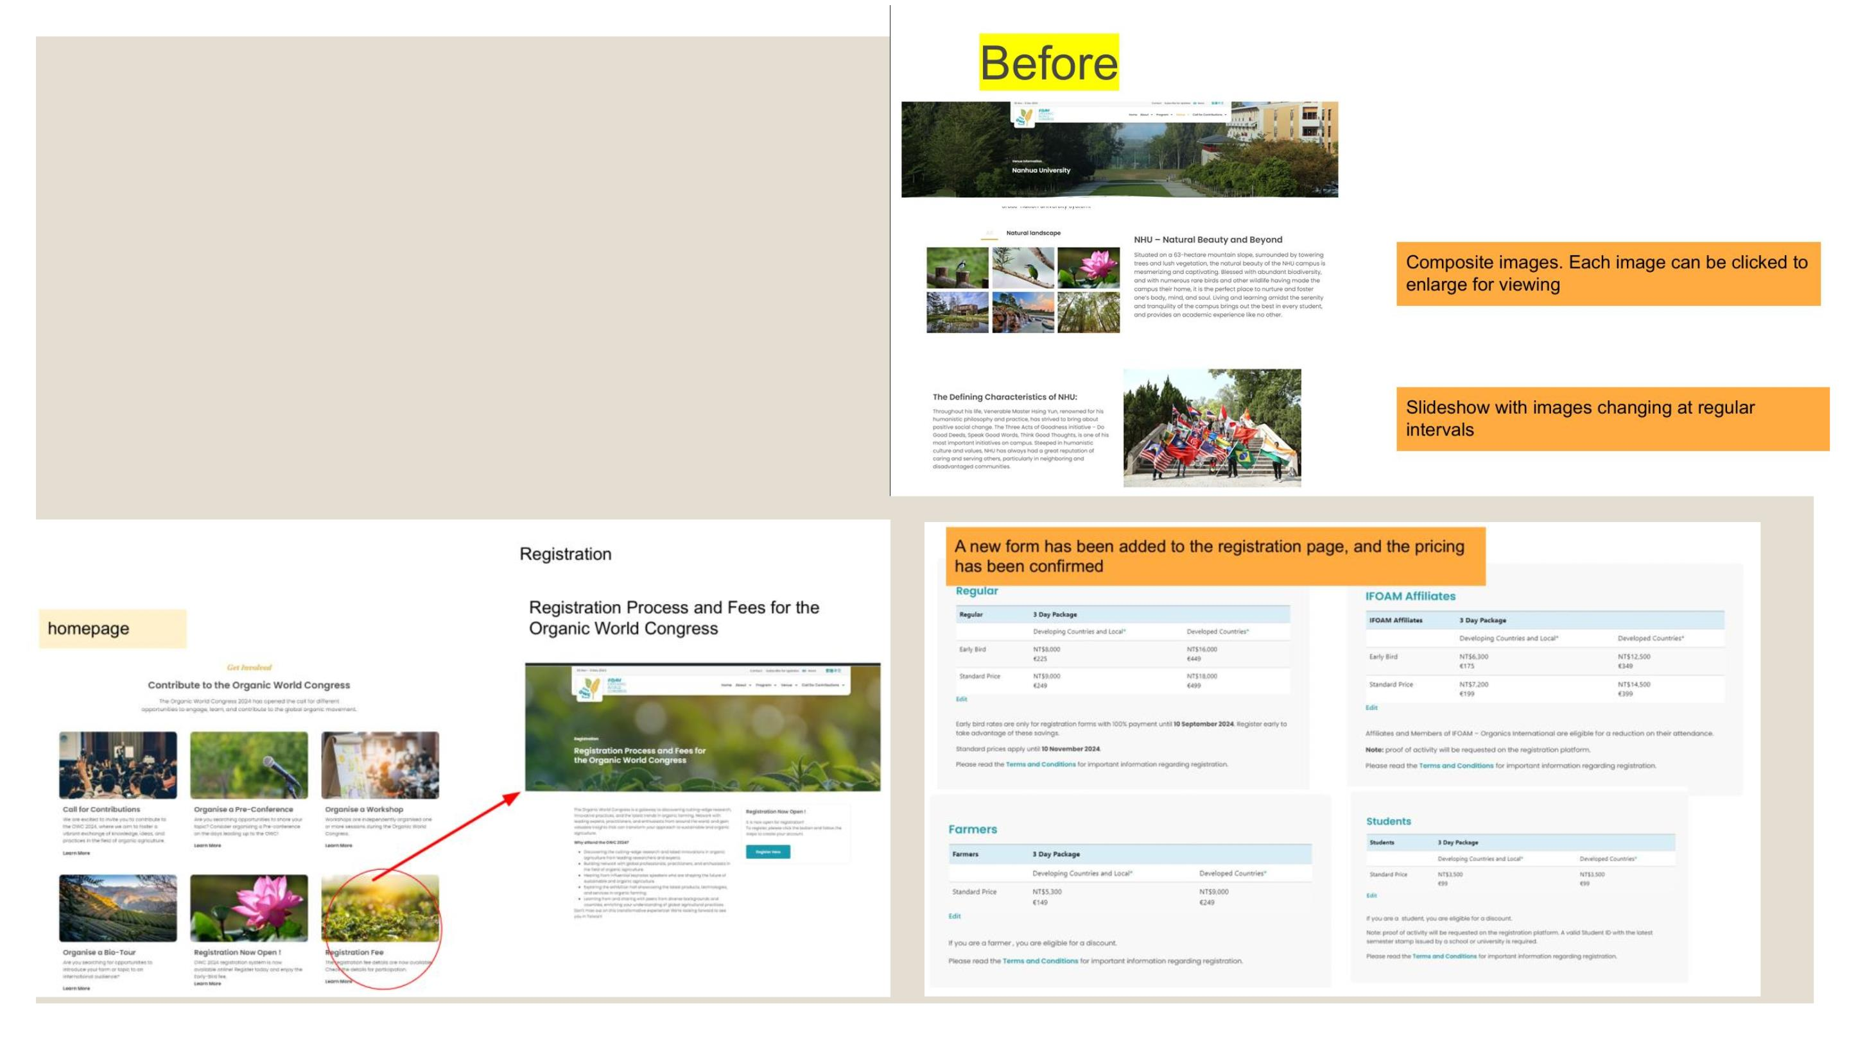
WebsiteꢀPlanningꢀ&ꢀMaintenance
Proactivelyꢀupdateꢀandꢀmaintainꢀwebsiteꢀlinksꢀ
andꢀimages
Developꢀnewꢀfeaturesꢀandꢀpagesꢀbasedꢀonꢀprojectꢀ
requirements.
17

Slide 18
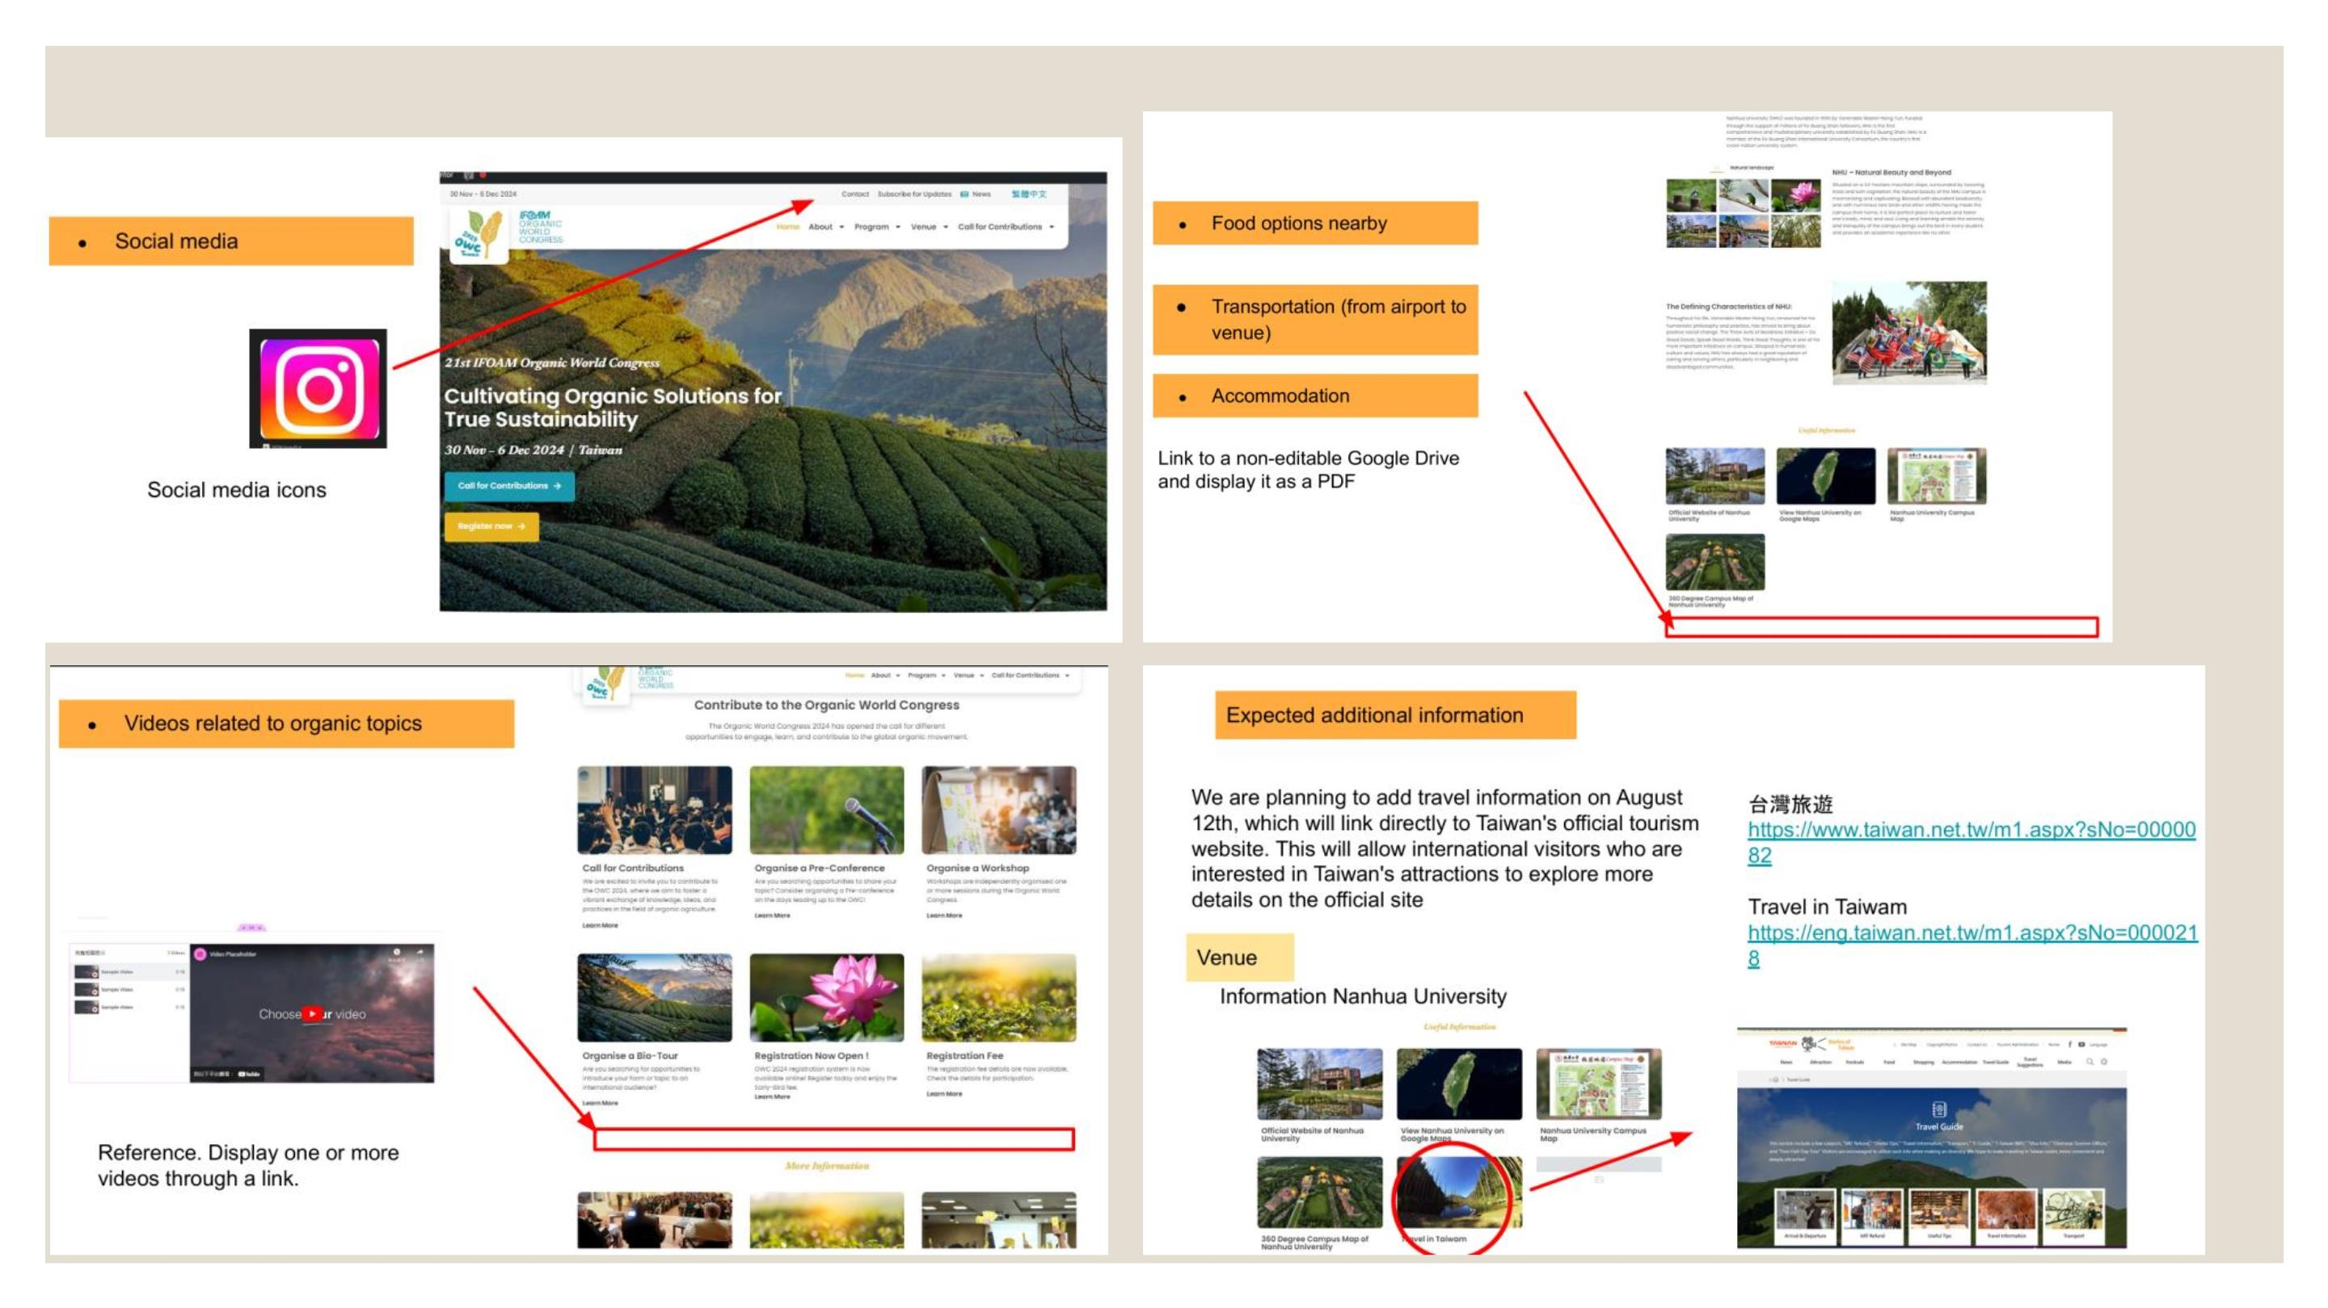
Initiative,ꢀadaptability,ꢀandꢀwillingnessꢀtoꢀlearnꢀinꢀnewꢀenvironments.
18

Slide 19
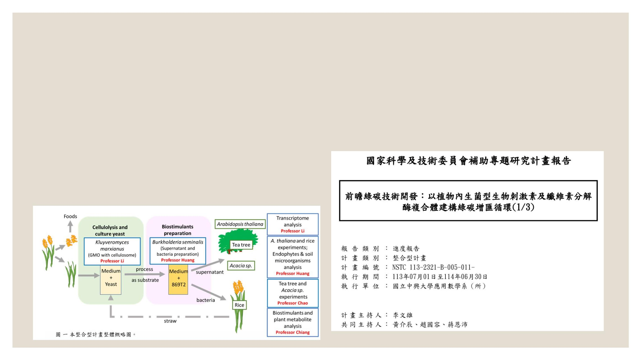
Strong cross-functional collaboration and teamwork abilities.
• NSTCꢀResearchꢀProjectꢀ(6ꢀLaboratories)
• SlovakiaꢀAcaciaꢀProjectꢀ(3ꢀLaboratories)
• NCSISTꢀProjectꢀ(1ꢀLaboratory)
19

Slide 20
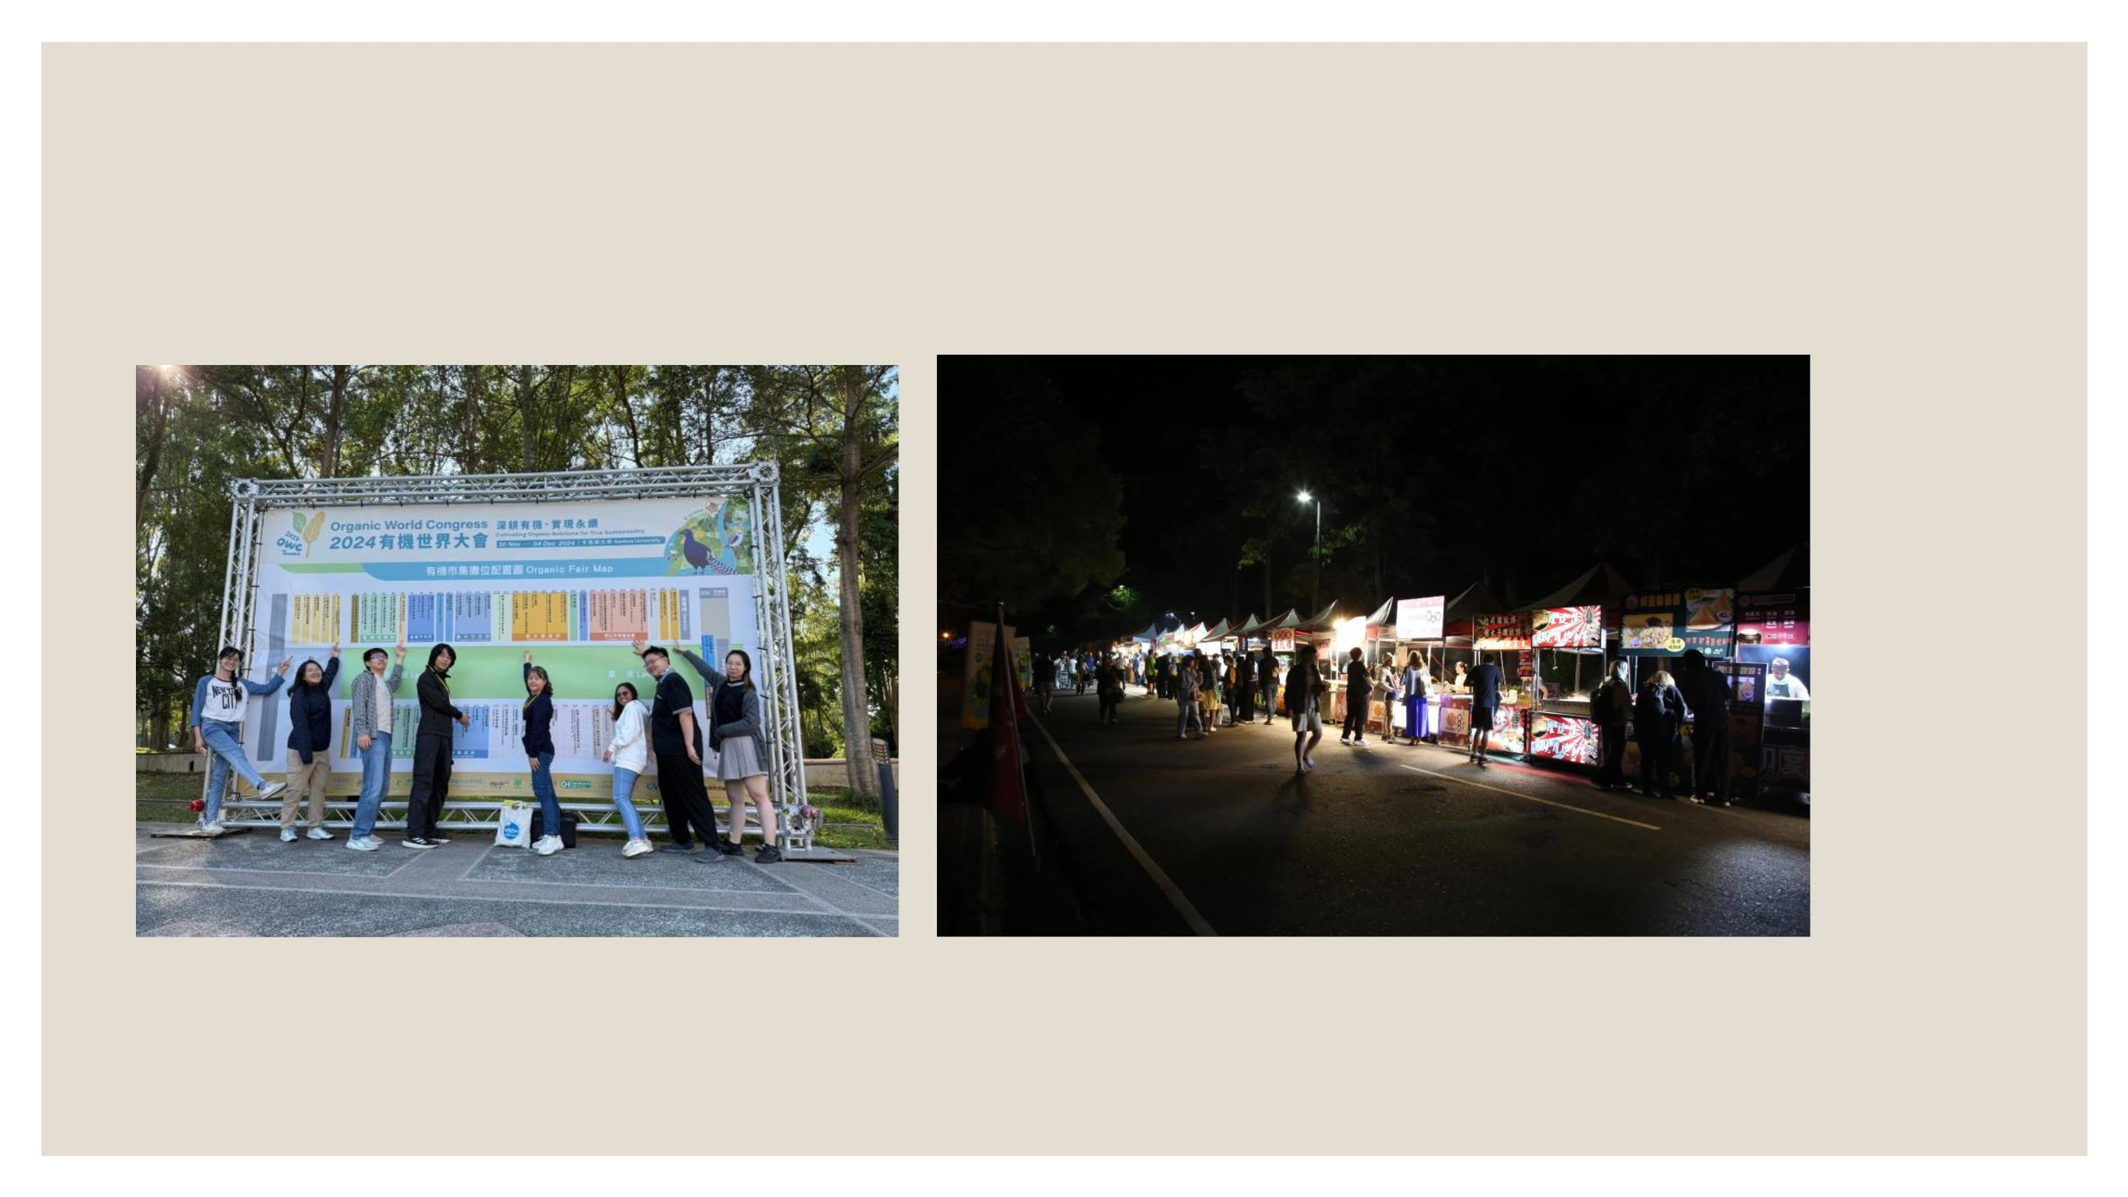
20

Slide 21

Effectsꢀofꢀbiostimulantsꢀonꢀteaꢀtrees
Academicꢀadvisor:
Dr.ꢀChieh-ChenꢀHuang
Dr.ꢀKuo-JungꢀChao
Dr.ꢀMeng-YuanꢀHuang
Speaker:
Jin-GongꢀZhang
21

Slide 22
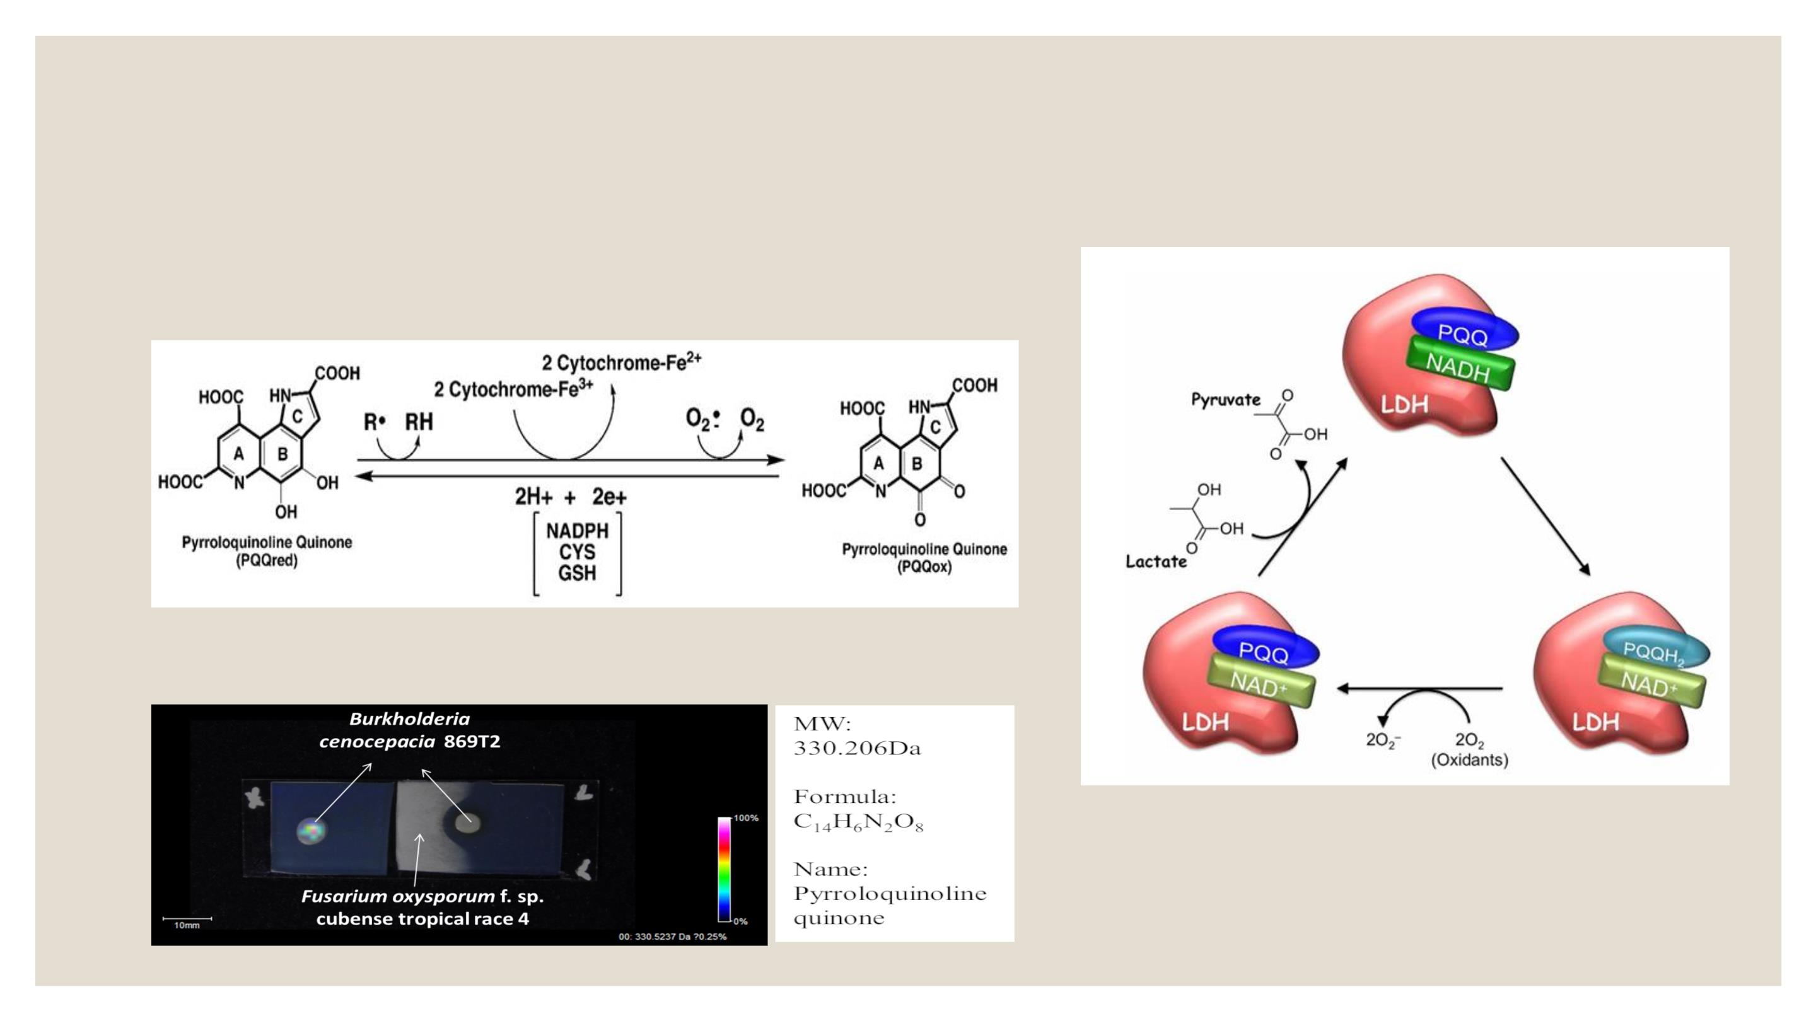
Introduction
Functionsꢀofꢀpyrroloquinolineꢀquinoneꢀ(PQQ)
Pyrroloquinoline quinone (PQQ) isꢀaꢀpotentialꢀnovelꢀ
biostimulant.
Figureꢀ4.ꢀMechanismꢀofꢀPQQ-mediatedꢀelectronꢀtransferꢀ
(Jonscherꢀetꢀal.,ꢀ2021)
Figureꢀ5.ꢀProposedꢀmechanismꢀforꢀPQQ-
dependentꢀenzymaticꢀreactionꢀofꢀLDHꢀviaꢀ
itsꢀredoxꢀactivity.
5
(Akagawa,ꢀ2016)
Figureꢀ3.ꢀPQQꢀ(Hung,ꢀYuꢀetꢀal.ꢀ2026)

Slide 23
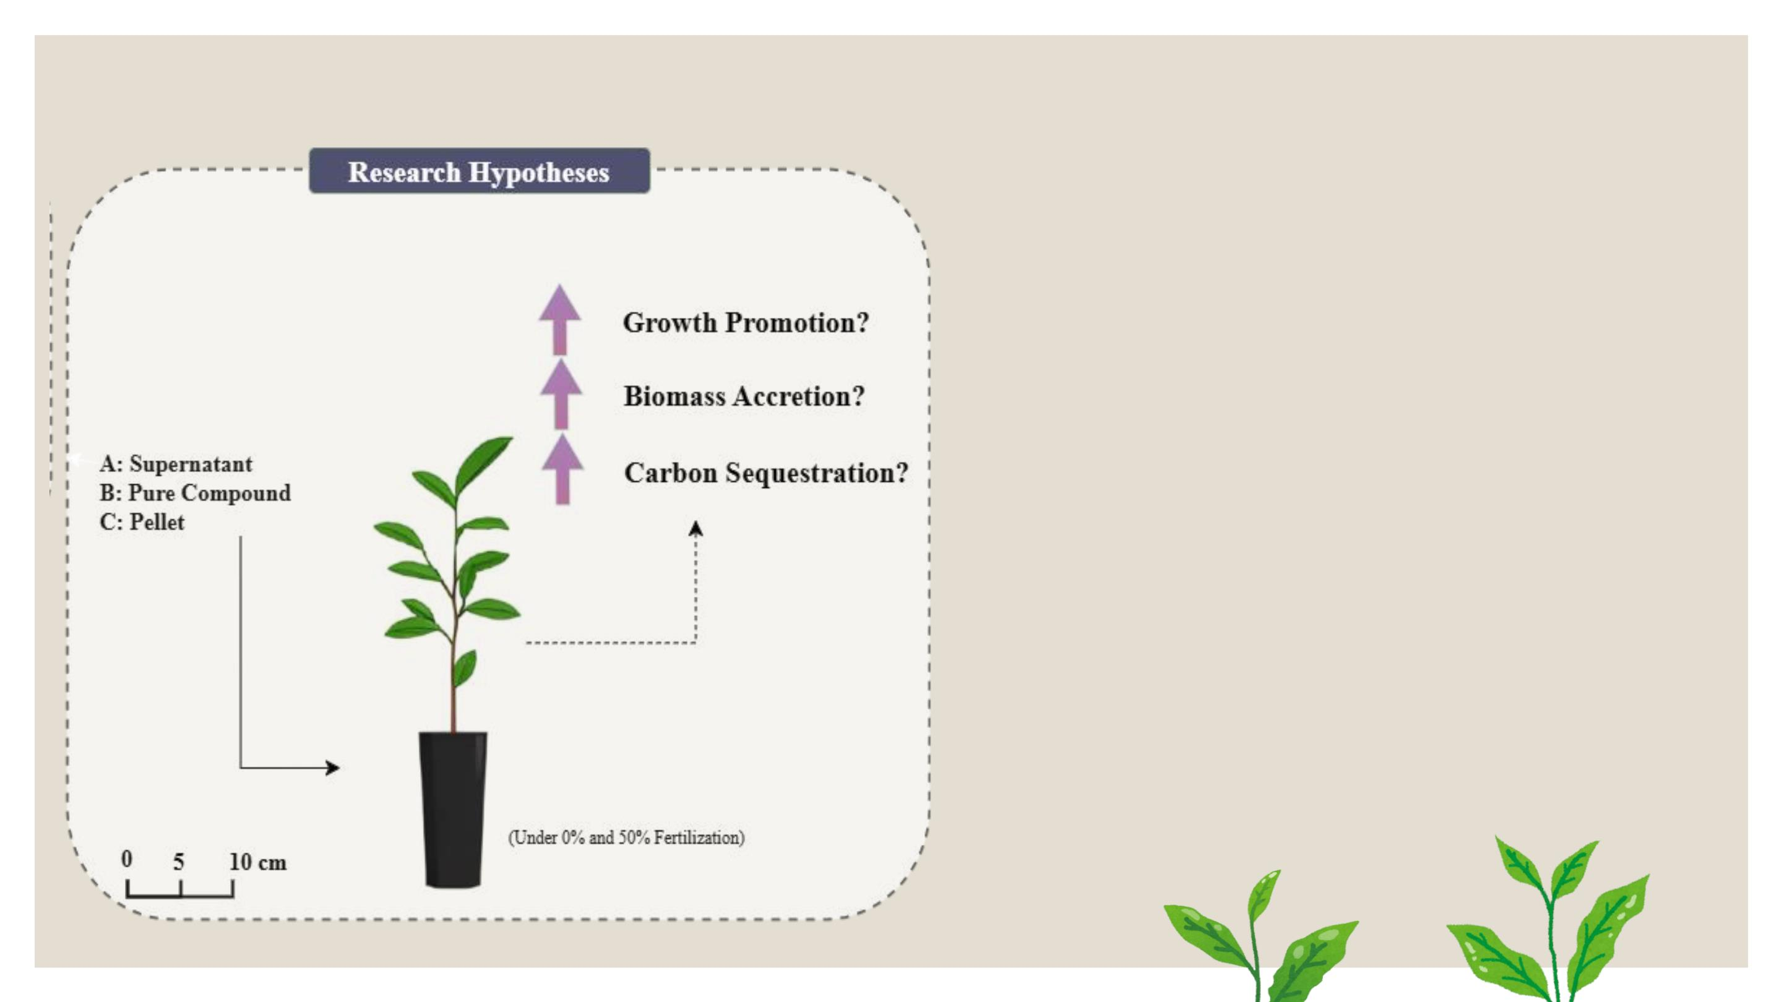
Introduction
Research Objectives
● Toꢀinvestigateꢀtheꢀpromotionꢀofꢀteaꢀplantꢀ
growthꢀbyꢀTSBSꢀunderꢀ0%ꢀandꢀ50%ꢀ
fertilizerꢀapplicationꢀrates.
● ToꢀevaluateꢀtheꢀeffectꢀofꢀTSBSꢀonꢀcarbonꢀ
sequestration.
Research Questions
● WhatꢀisꢀtheꢀeffectꢀofꢀtheꢀTSBS biostimulantꢀ
onꢀteaꢀplantsꢀunderꢀ0% fertilizationꢀ(noꢀ
syntheticꢀfertilizer)?
● Whatꢀisꢀtheꢀeffectꢀofꢀapplyingꢀtheꢀ
biostimulantꢀonꢀteaꢀplantsꢀunderꢀ50% of the
conventional fertilizationꢀrate?
23
Figureꢀ6.ꢀResearchꢀHypothesis

Slide 24
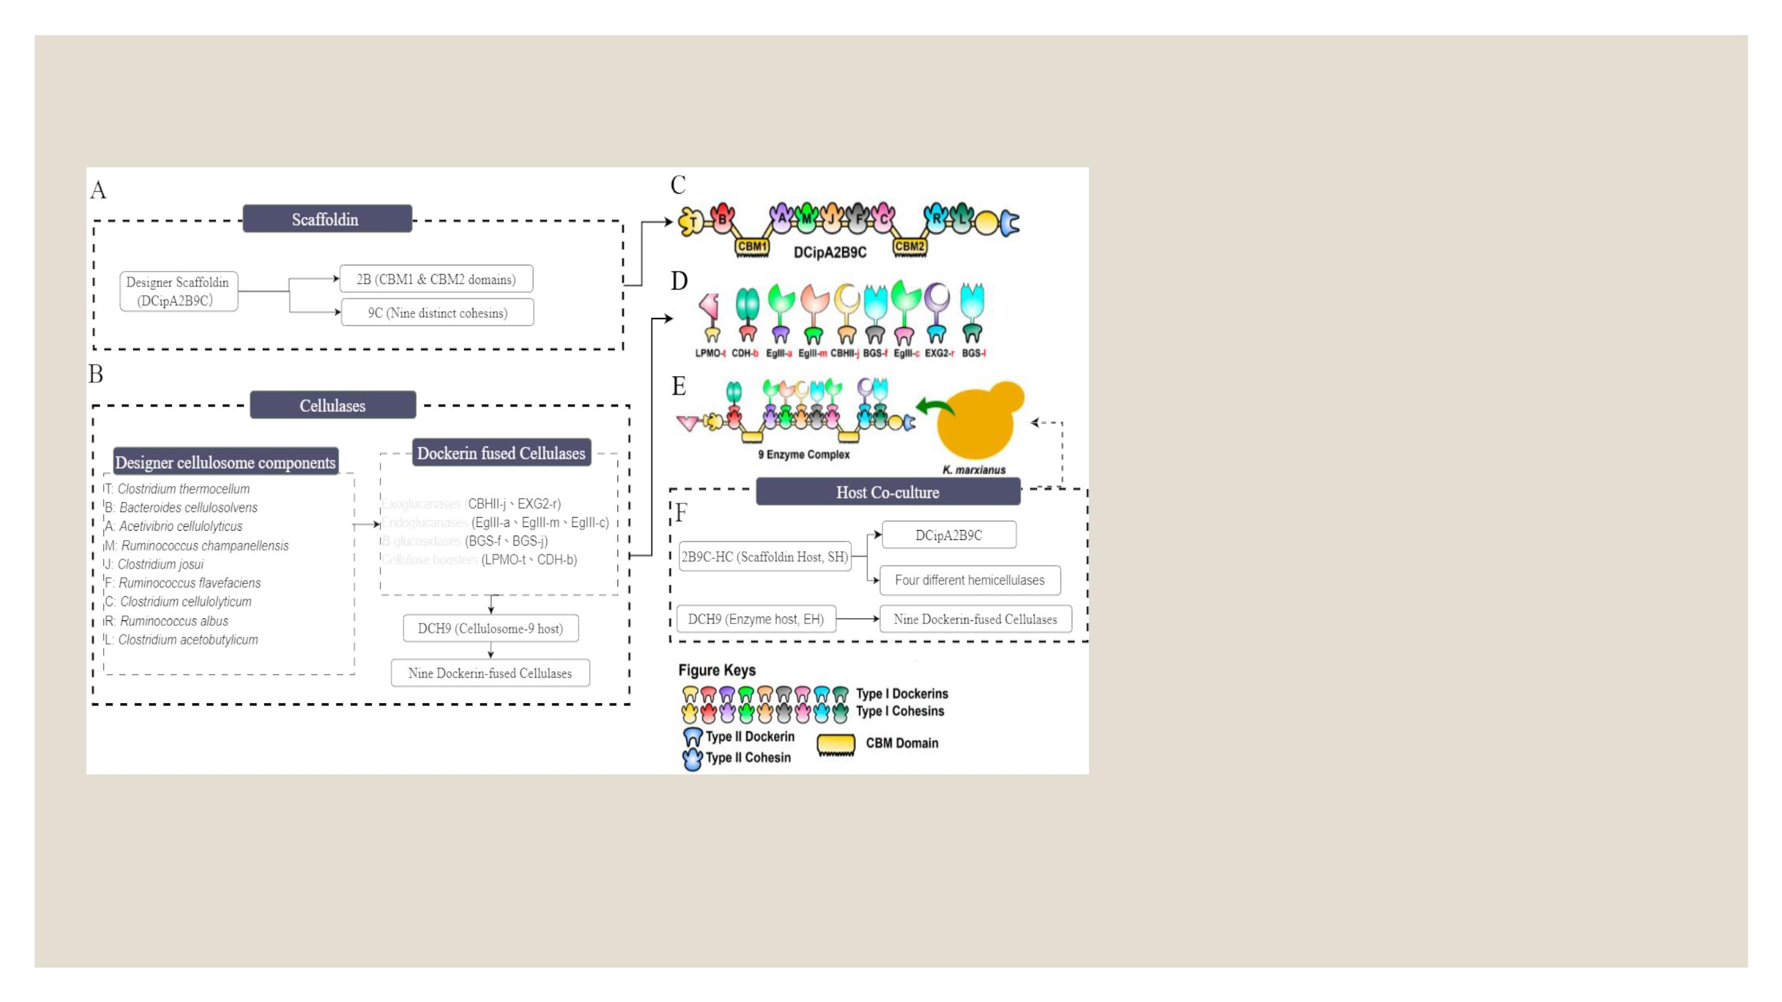
Introduction
Figureꢀ4.ꢀSchematicꢀillustrationꢀofꢀtheꢀengineeredꢀcellulosomeꢀsystem
Kluyveromycesꢀmarxianusꢀasꢀaꢀsecretionꢀplatform.ꢀTheꢀsystemꢀintegratesꢀaꢀscaffoldinꢀhostꢀ(SH),ꢀexpressingꢀtheꢀ
2B9C-HCꢀscaffoldꢀprotein,ꢀwithꢀanꢀenzymeꢀhostꢀ(EH),ꢀexpressingꢀDCH9ꢀenzymes,ꢀthroughꢀaꢀco-cultivationꢀstrategyꢀ
toꢀfacilitateꢀfunctionalꢀassembly.
DevelopedꢀandꢀprovidedꢀbyꢀtheꢀresearchꢀteamꢀofꢀAcademicianꢀWen-HsiungꢀLiꢀ(BiodiversityꢀResearchꢀCenter,ꢀ
AcademiaꢀSinica)(Anandharaj,ꢀLinꢀetꢀal.ꢀ2020)。
24

Slide 25
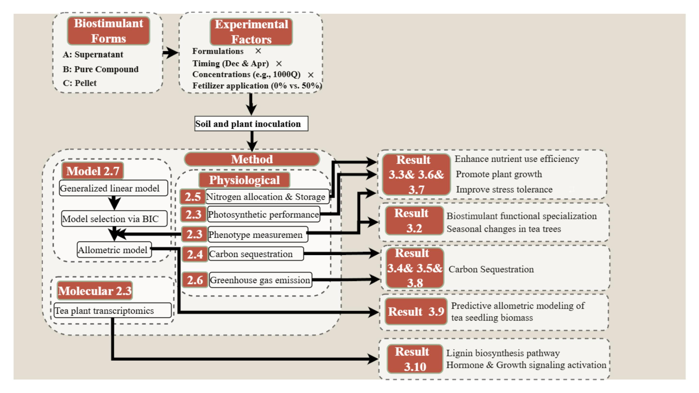
25

Slide 26
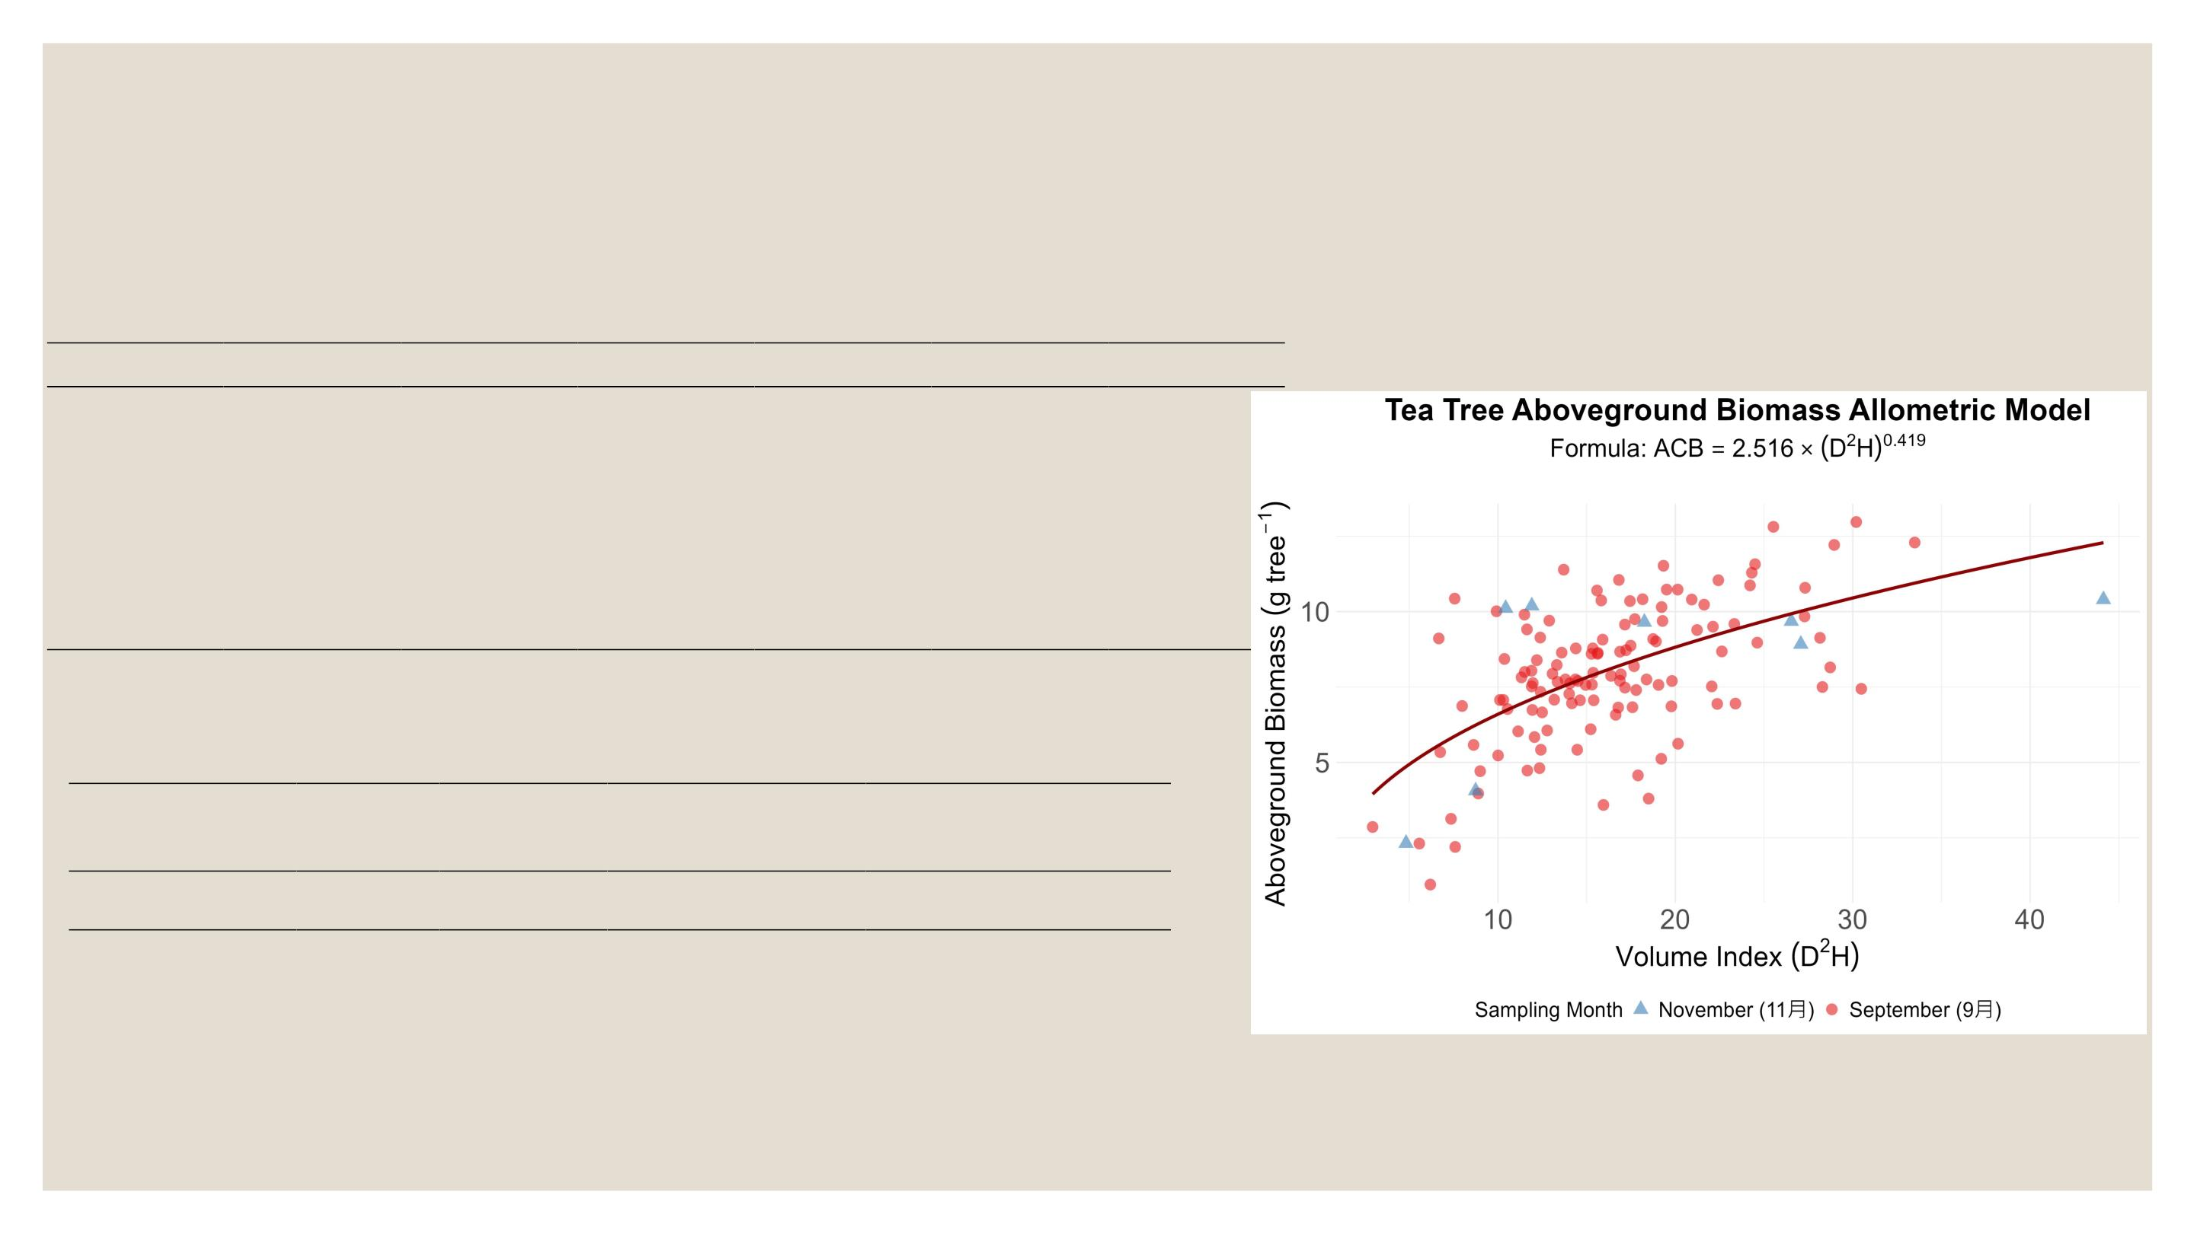
Results
Generalized linear model
Trait
n
Adj_R²
0.3067 540.22 548.8
0.235
0.213
AIC
BIC
RMSE
1.919
P_Value
6.00E-12
2.32E-09
4.12E-08
1.40E-07
D²H_New 129
基徑新 132
基徑舊 124
基徑+樹 129
長(總長)
566.58 575.23 2.023
531.1 539.56 2.011
0.1905 560.21 568.79 2.073
樹長
129
0.1873 560.72 569.3 2.077
1.81E-07
Table 4 Nonlinear least squares (NLS)
Model_Name AIC
BIC
RMSE P_Valu ResidualꢀStandardꢀ
Errorꢀ(RSE)
e
NLS_Model 532.81 541.39 1.879 <ꢀ0.001ꢀ 1.88
Note:ꢀTheꢀinitialꢀvaluesꢀofꢀparametersꢀaꢀandꢀbꢀforꢀtheꢀNLSꢀmodelꢀwereꢀ
derivedꢀfromꢀtheꢀlog-transformedꢀequation:ꢀlog(AGB)ꢀ=ꢀlog(a)ꢀ+ꢀbꢀ×ꢀ
log(D²H).
Figure 14 Nonlinear least squares (NLS)
26

Slide 27
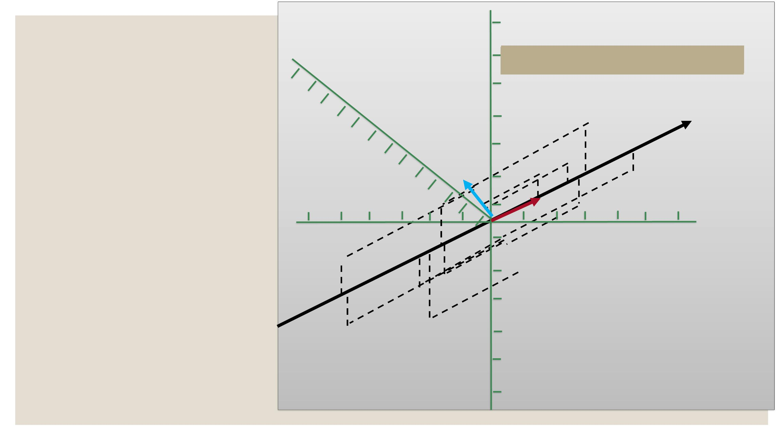
MaterialsꢀandꢀMethods
y
Phenotype A
(exꢀStemꢀdryꢀweigh….ꢀ)
Phenotype (n+1)
z
PCA
7
Reconstruction Error: 43.2
.
.
.
.
.
.
.
PCAꢀreducesꢀ
.
PC1
multidimensionalꢀplantꢀtraitꢀ
dataꢀintoꢀprincipalꢀ
components,ꢀrevealingꢀ
patternsꢀandꢀtraitꢀassociations.
.
. .
x
.
.
.
.
.
Phenotype B
(exꢀStemꢀdryꢀweight…)
.
.
.
.
27

Slide 28
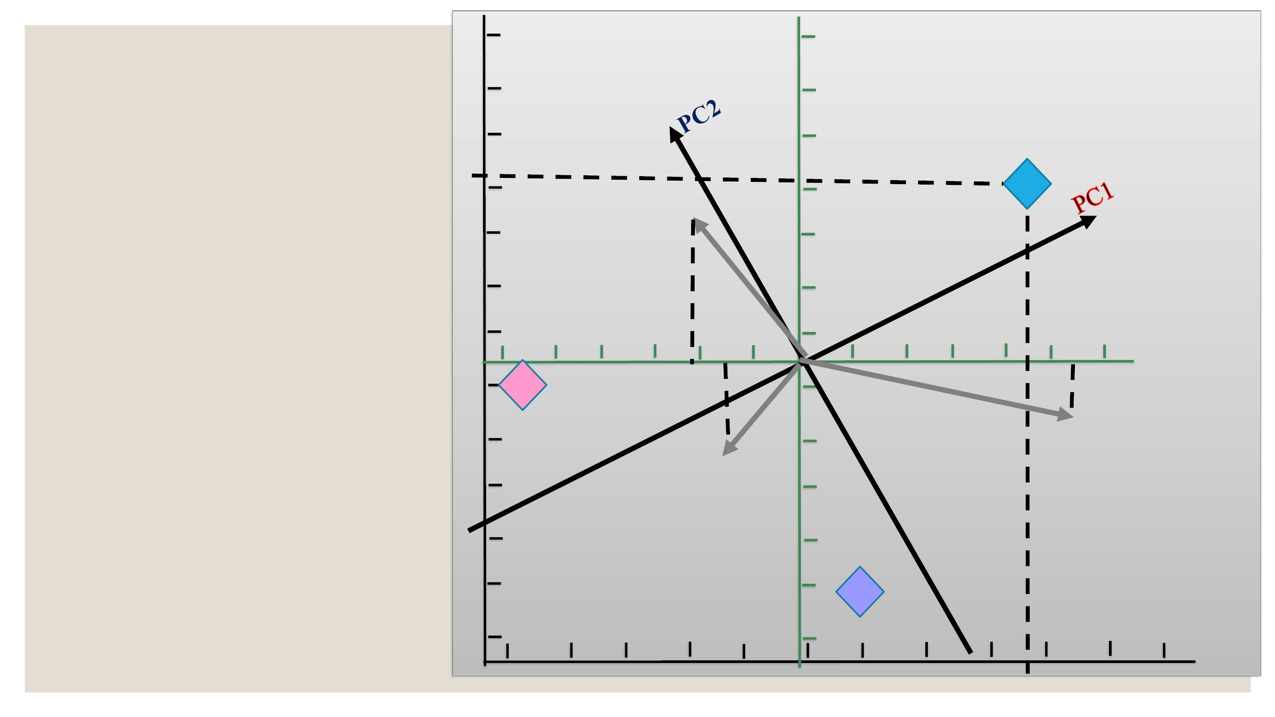
MaterialsꢀandꢀMethods
y
PCA
.
.
.
Phenotype C
.
.
.
Arrows/Vectors
<90°ꢀpositivelyꢀrelated
=90ꢀ°ꢀunrelated
.
.
.
.
x
.
.
>90ꢀ°ꢀnegativelyꢀrelatedꢀꢀ
.
Phenotype A
Phenotype B
.
.
28

Slide 29
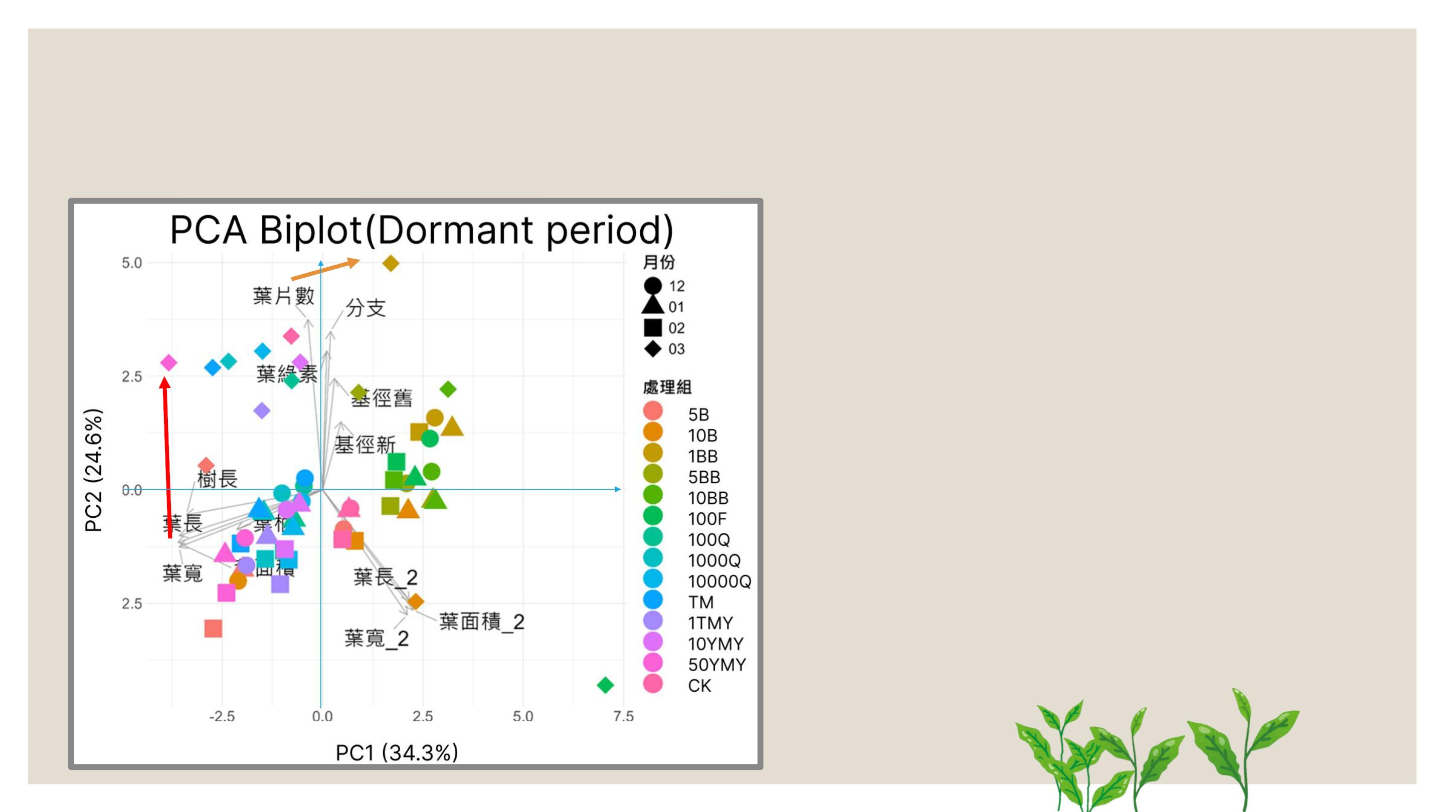
Results
Effects of the TSBS biostimulant on tea plants under 0 fertilization
● PC1 + PC2 = 58.9%ꢀofꢀtotalꢀ
variance
● Best performance:ꢀ
1. PC1ꢀꢀ葉面積ꢀLeafꢀarea:
50MFY (Mar.)
葉面積
2. PC2ꢀꢀ葉片數ꢀLeafꢀnumber:ꢀꢀꢀ
ꢀ1BB (Mar.)
29

Slide 30
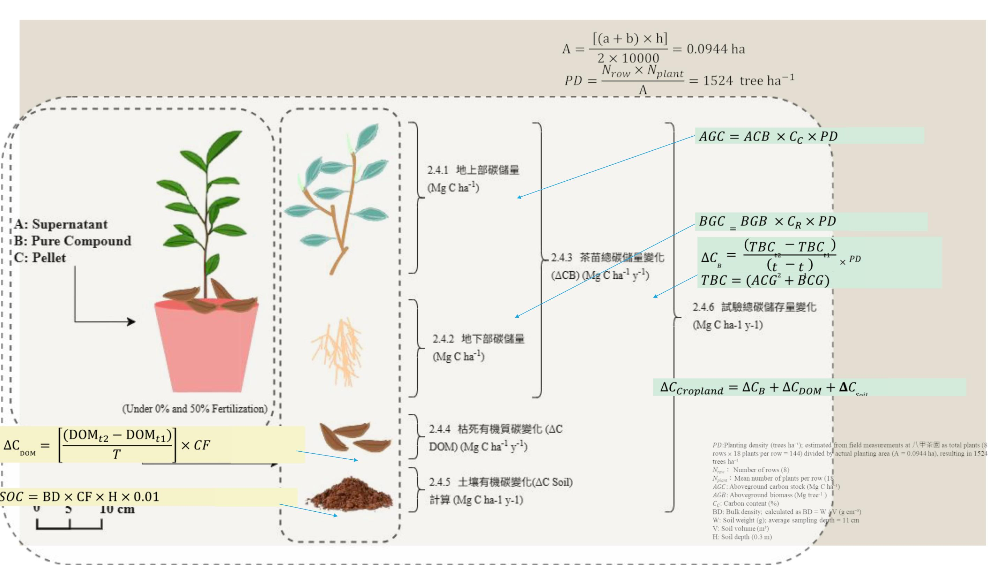
MaterialsꢀandꢀMethods
equationꢀ9
Phenotypeꢀmeasure
equationꢀ10
equationꢀ11
Aboveground Carbon
Stock (Mg C ha⁻¹)
equationꢀ12
equationꢀ13
Aboveground Biomass
(Mg ha⁻¹ )
equationꢀ14
TotalꢀCarbonꢀStockꢀ(TCB)ꢀ
(Baseline-adjusted)ꢀ(MgꢀCꢀha⁻¹y⁻¹)
AnnualꢀChangeꢀinꢀTotalꢀCarbonꢀ
Stockꢀ(ΔC₍Cropland₎)ꢀ(MgꢀCꢀha⁻¹ꢀ
yr⁻¹)
Belowground carbon
stock(Mg C ha⁻¹)
equationꢀ17
Belowground biomass
(Mg ha⁻¹)
equationꢀ15
ꢀ
Litter Carbon
LitterꢀCarbonꢀStockꢀ(MgꢀCꢀha⁻¹ꢀyꢀ⁻¹ꢀ)
Stock (Mg C ha⁻¹)
equationꢀ16
Soil organic carbon
stock (Mg C ha⁻¹ )
Soilꢀorganicꢀcarbonꢀstockꢀ(MgꢀCꢀha⁻¹ꢀyꢀ⁻¹ꢀ)
30

Slide 31
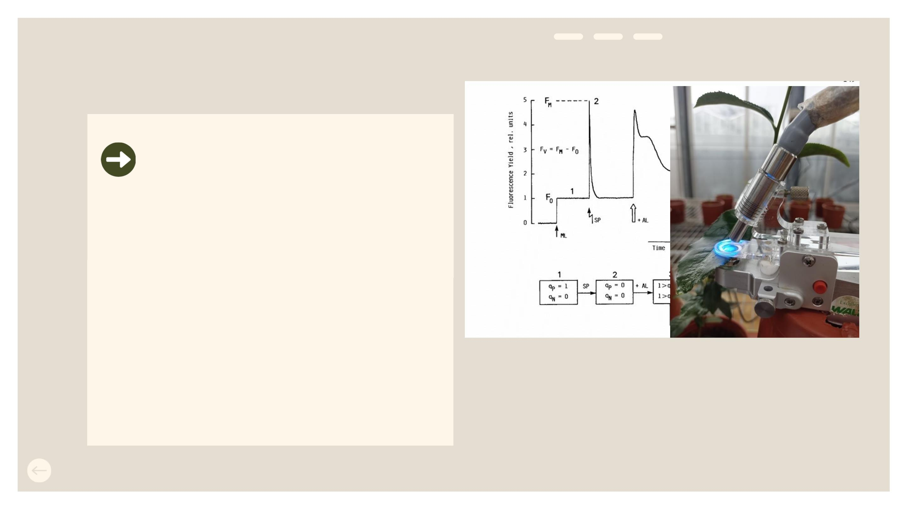
MaterialsꢀandꢀMethods
Mini-PAM fluorescence measurement
F / Fm
V
• maximumꢀphotochemicalꢀ
quantumꢀyieldꢀofꢀPhotosystemꢀII
• Growth-stageꢀstable
• Conservedꢀ(0.7–0.8)
• Robustꢀstressꢀindicator
Fig. 15. Principles of Mini-PAM fluorescence
measurement
F :ꢀ黑暗中最小F :ꢀ光照下穩態螢光
0
t
F’₀:ꢀ光照下最小
F_{m}:ꢀ黑暗中最大螢光
F’_{m}:ꢀ光照下最大螢光
F_{v}:可變螢光(variableꢀfluorescence)
31

Slide 32
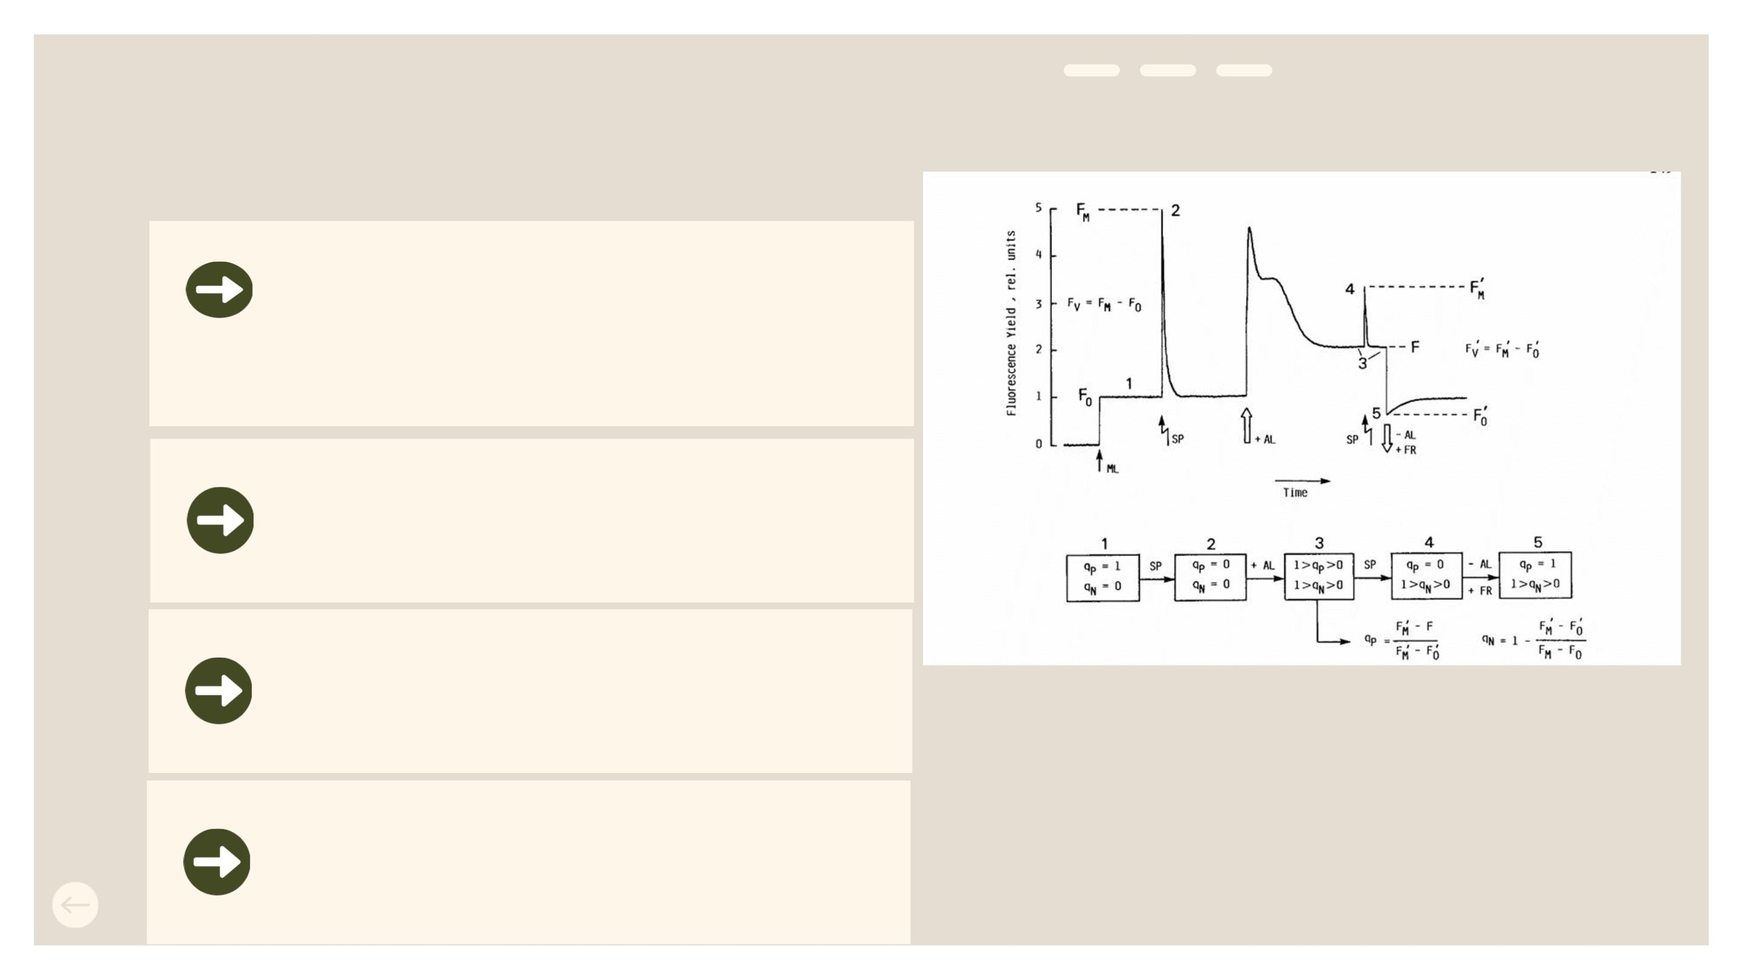
MaterialsꢀandꢀMethods
Mini-PAM fluorescence measurement
光化學猝滅Y(II)
Measuresꢀtheꢀefficiencyꢀofꢀlightꢀenergyꢀ
conversionꢀinꢀactiveꢀphotosynthesis.
非光化學猝滅Y(NPQ)
Egulatedꢀheatꢀdissipationꢀofꢀexcessꢀ
lightꢀenergy.
非光化學猝滅Y(NO)
Non-regulatedꢀenergyꢀdissipationꢀ
associatedꢀwithꢀphotodamageꢀrisk
Fig. 14. Principles of Mini-PAM fluorescence
measurement
F :ꢀ黑暗中最小F :ꢀ光照下穩態螢光
0
t
ETR
F’₀:ꢀ光照下最小
F_{m}:ꢀ黑暗中最大螢光
F’_{m}:ꢀ光照下最大螢光
F_{v}:可變螢光(variableꢀfluorescence)
stimatesꢀtheꢀrateꢀofꢀphotosyntheticꢀ
electronꢀtransportꢀinꢀPSII
32

Slide 33
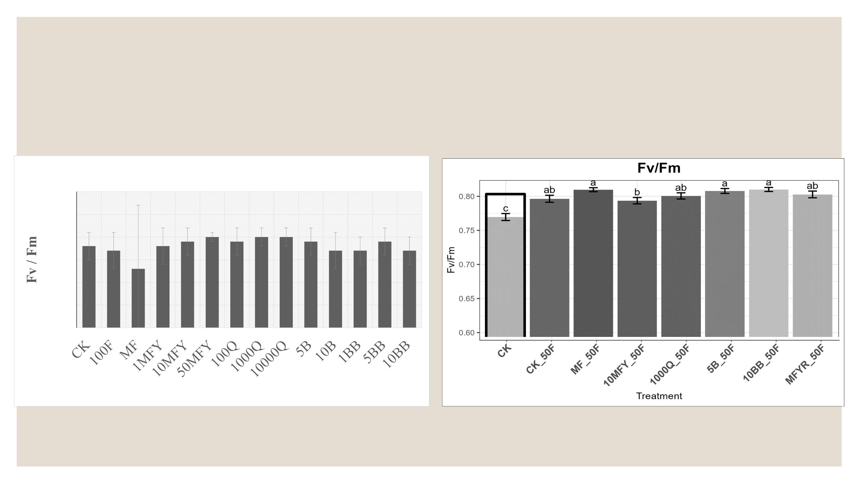
Results
Mini-PAM fluorescence measurement
• BiostimulantsꢀShowedꢀNoꢀPhytotoxicityꢀinꢀTeaꢀSeedlings
• FertilizerꢀDeficiencyꢀImposedꢀStressꢀonꢀTeaꢀSeedlings
Fv / Fm
0.9
0.85
0.8
0.75
0.7
0.65
0.6
Treatment
33
Kruskal-Wallisꢀtest,ꢀpꢀ<ꢀ0.05;ꢀdifferentꢀlettersꢀindicateꢀsignificantꢀdifferencesꢀ(Dunn’sꢀtest,ꢀBHꢀadjustment)

Slide 34
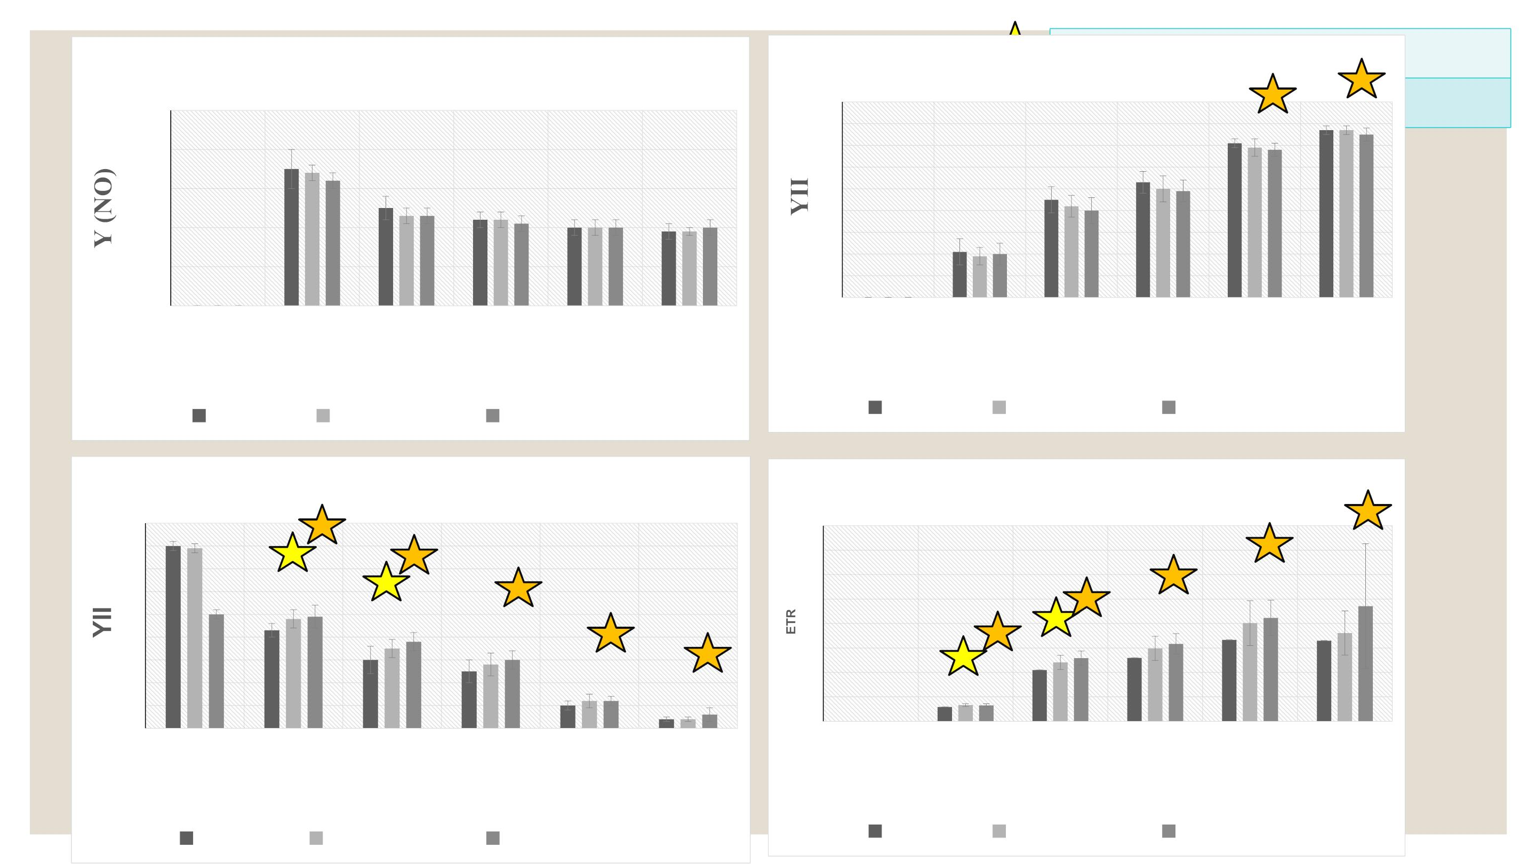
Results
Kruskal-Wallisꢀtest,ꢀpꢀ<ꢀ0.05;ꢀdifferentꢀlettersꢀindicateꢀsignificantꢀdifferencesꢀ(Dunn’sꢀtest,ꢀBHꢀadjustment)
Y (NO)
Y (NPQ)
east (A)
0.5
0.4
0.3
0.2
0.1
0.9
0.8
0.7
0.6
0.5
0.4
0.3
0.2
0.1
0
*
*
0
0
30
160
250
810 1950
0
30
160 250 810 1950
PAR(μmol photons m⁻² s⁻¹)
PAR(μmol photons m⁻² s⁻¹)
CK_50F 10MFY_50F 1000Q_50F
CK_50F 10MFY_50F 1000Q_50F
ꢀYII
ETR
0.9
0.8
0.7
0.6
0.5
0.4
0.3
0.2
0.1
0
80
70
60
50
40
30
20
10
0
*
*
*
*
*
*
*
*
*
*
*
*
*
*
0
30
160
250
810
1950
0
30
160
250
810 1950
PAR(μmol photons m⁻² s⁻¹)
PAR(μmol photons m⁻² s⁻¹)
34
CK_50F 10MFY_50F 1000Q_50F
CK_50F 10MFY_50F 1000Q_50F

Slide 35
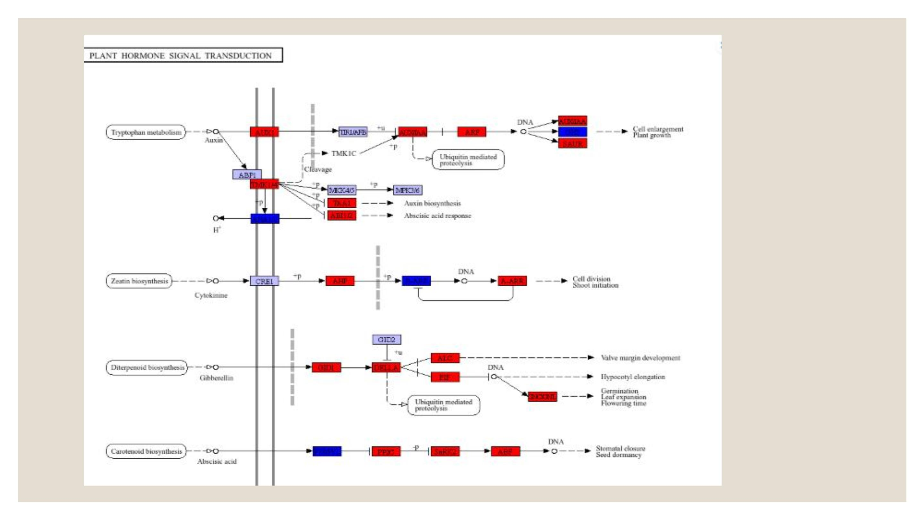
35

Slide 36
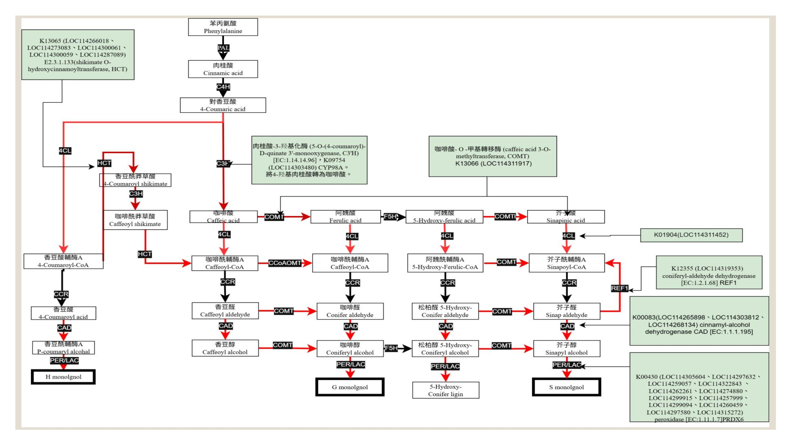
36

Slide 37

Thankꢀyouꢀforꢀlistening
37

Slide 38
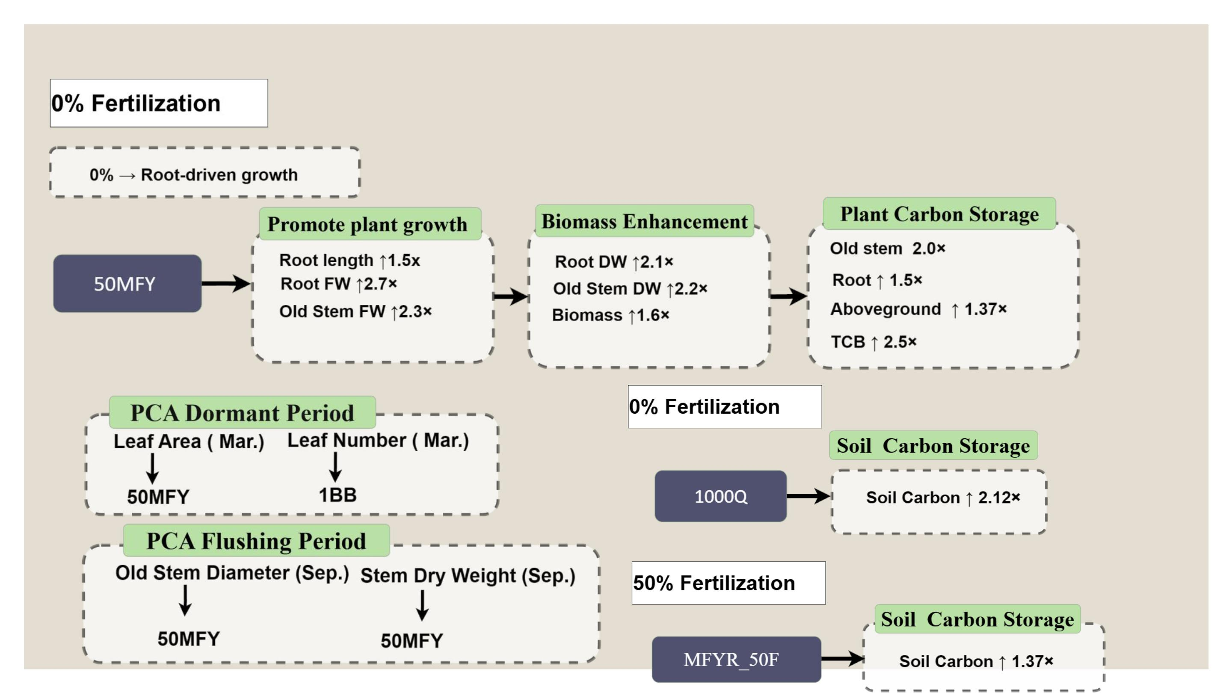
Discussion
38

Slide 39
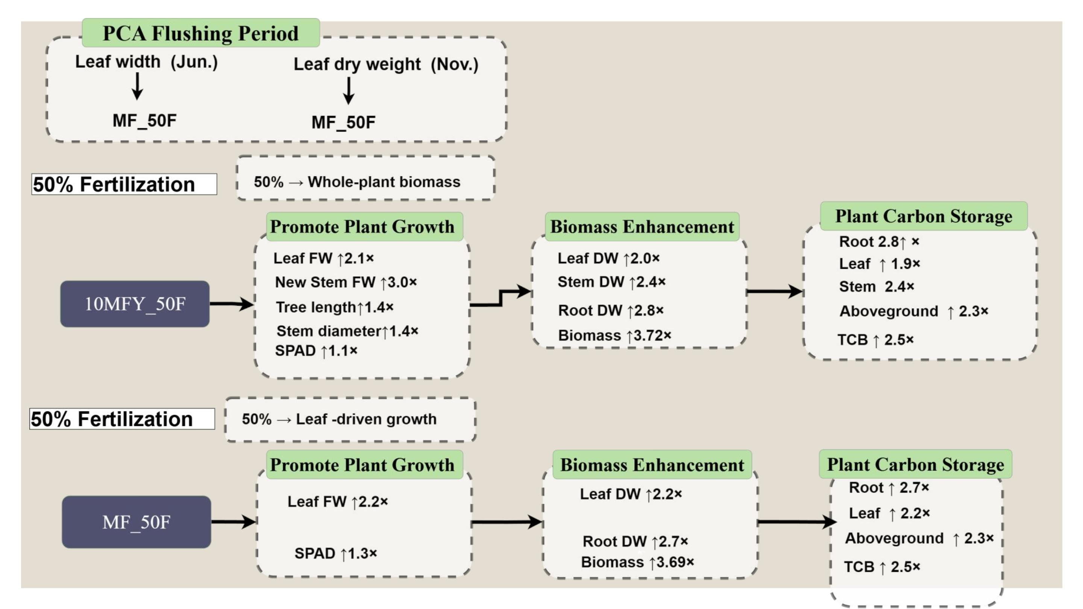
39

Slide 40
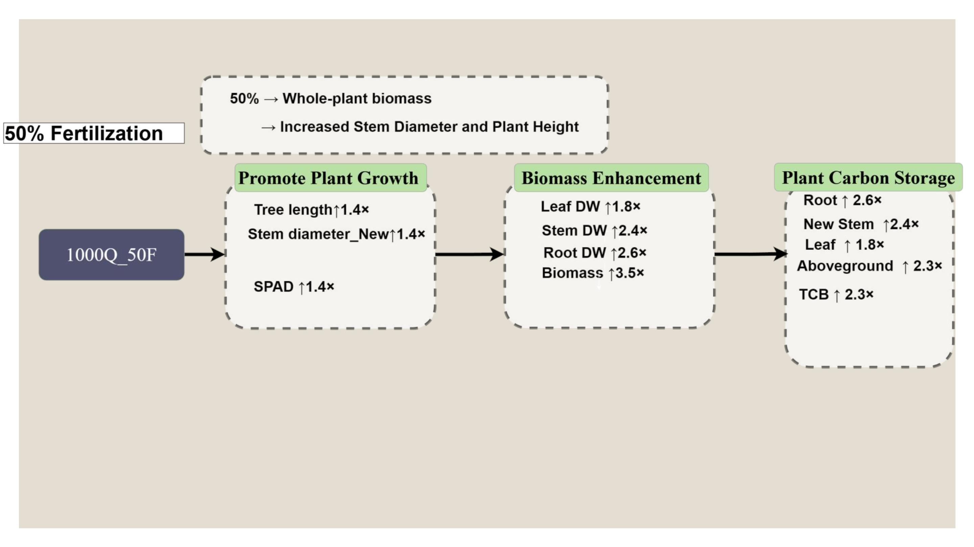
40

Slide 41

Conclusion
● Thisꢀstudyꢀdemonstratesꢀthatꢀtheꢀdevelopmentꢀofꢀcultureꢀmediaꢀbasedꢀonꢀ
differentꢀcategoriesꢀofꢀagriculturalꢀandꢀfood-processingꢀby-productsꢀandꢀ
wastes,ꢀtogetherꢀwithꢀpredictiveꢀmodeling,ꢀprovidesꢀaꢀpromisingꢀapproachꢀ
forꢀlarge-scaleꢀproductionꢀandꢀfieldꢀapplicationꢀinꢀtheꢀfuture.
● Overall,ꢀthisꢀstudyꢀconfirmsꢀthatꢀTSBSꢀbiostimulantsꢀderivedꢀfromꢀ
supernatantsꢀareꢀeffectiveꢀandꢀhighlyꢀpromisingꢀforꢀpromotingꢀteaꢀseedlingꢀ
growthꢀandꢀdevelopment.
41

Slide 42

5.ꢀReferences
1. Akagawa, M., Minematsu, K., Shibata, T., Kondo, T., Ishii, T., & Uchida, K. (2016).ꢀIdentificationꢀofꢀlactateꢀ
dehydrogenaseꢀasꢀaꢀmammalianꢀpyrroloquinolineꢀquinoneꢀ(PQQ)-bindingꢀprotein.ꢀScientificꢀreports,ꢀ6(1),ꢀ
26723.
2. Ahmed,ꢀS.,ꢀGriffin,ꢀT.,ꢀCash,ꢀS.ꢀB.,ꢀHan,ꢀW.ꢀY.,ꢀMatyas,ꢀC.,ꢀLong,ꢀC.,ꢀ...ꢀ&ꢀXue,ꢀD.ꢀ(2018).ꢀGlobalꢀclimateꢀ
change,ꢀecologicalꢀstress,ꢀandꢀteaꢀproduction.ꢀInꢀStressꢀphysiologyꢀofꢀteaꢀinꢀtheꢀfaceꢀofꢀclimateꢀchangeꢀ(pp.ꢀ1-
23).ꢀSingapore:ꢀSpringerꢀSingapore.
3. Fang, T., Lo, S.-C., Yu, Y.-N., Sou, N.-L., Hung, S.-H.W., Peng, J.-H., Chiang, E.-P.I., Huang, C.-C.ꢀ
DevelopmentꢀofꢀanꢀEngineeredꢀBacterialꢀEndophyte:ꢀPromotingꢀPlantꢀGrowthꢀThroughꢀPyrroloquinolineꢀ
Quinoneꢀ(PQQ)ꢀSynthesis.ꢀMicroorganismsꢀ2025,ꢀ13,ꢀ293.
4. Hung, S. H. W., Huang, T. C., Lai, Y. C., Wu, I. C., Liu, C. H., Huarng, Y. F., ... & Huang, C. C.ꢀ
EndophyticꢀBiostimulantsꢀforꢀSmartꢀAgriculture:ꢀBurkholderia seminalis 869T2ꢀBenefitsꢀHeadingꢀLeafyꢀ
VegetablesꢀIn-FieldꢀManagementꢀinꢀTaiwan.ꢀAgronomyꢀ2023,ꢀ13,ꢀ967.
5. HO, Ying-Ning, et al.ꢀInꢀplantaꢀbiocontrolꢀofꢀsoilborneꢀFusariumꢀwiltꢀofꢀbananaꢀthroughꢀaꢀplantꢀendophyticꢀ
bacterium,ꢀBurkholderiaꢀcenocepaciaꢀ869T2.ꢀPlant and Soil,ꢀ2015,ꢀ387:ꢀ295-306.
6. Zhu W, Klinman JP.ꢀBiogenesisꢀofꢀtheꢀpeptide-derivedꢀredoxꢀcofactorꢀpyrroloquinolineꢀquinone.ꢀCurrꢀOpinꢀ
ChemꢀBiol.ꢀ2020,ꢀ59,ꢀ93-103.
7. Giri,ꢀN.ꢀA.,ꢀSakhale,ꢀB.ꢀK.,ꢀ&ꢀNirmal,ꢀN.ꢀP.ꢀ(2023).ꢀFunctionalꢀbeverages:ꢀanꢀemergingꢀtrendꢀinꢀbeverageꢀworld.ꢀ
RecentꢀFrontiersꢀofꢀPhytochemicals,ꢀ123-142.
Pramanik,ꢀP.,ꢀ&ꢀPhukan,ꢀM.ꢀ(2020).ꢀAssimilatingꢀatmosphericꢀcarbonꢀdioxideꢀinꢀteaꢀgardensꢀofꢀnortheastꢀIndia.ꢀ
Journalꢀofꢀenvironmentalꢀmanagement,ꢀ256,ꢀ109912.
42

